Slide 1
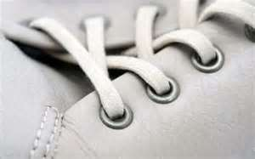
Macro Objects

Slide 2
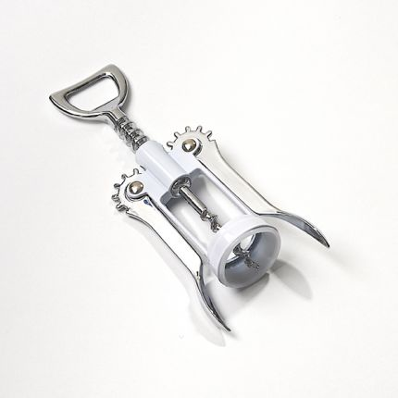
What does “Macro” mean?
Macro:
Large in scope or extent; large-scale.
Shows extreme details
Zoom in…Zoom in…Zoom in!

Slide 3
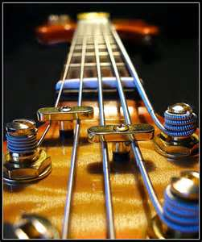
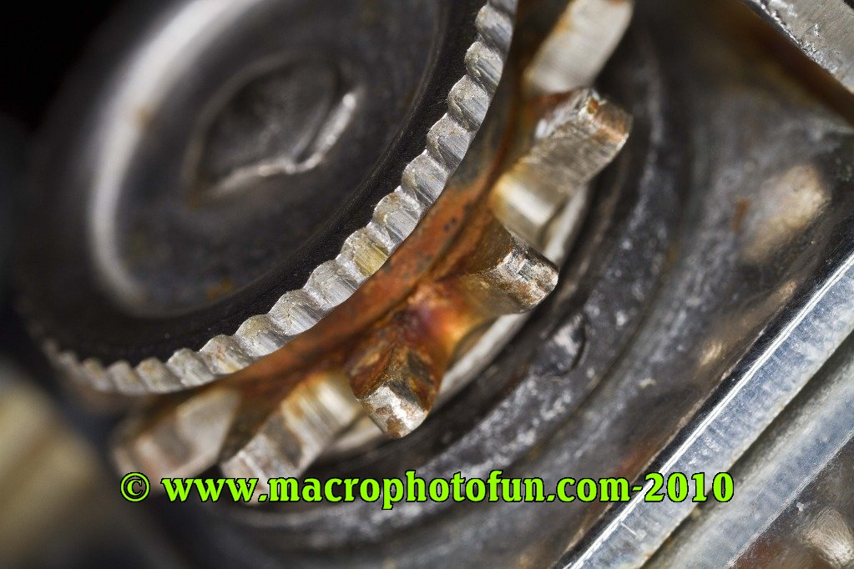
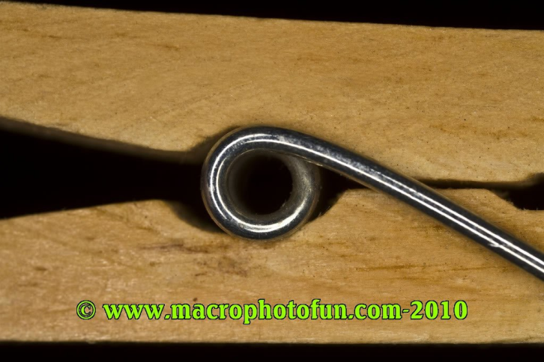
Examples of Macro Photography

Slide 4
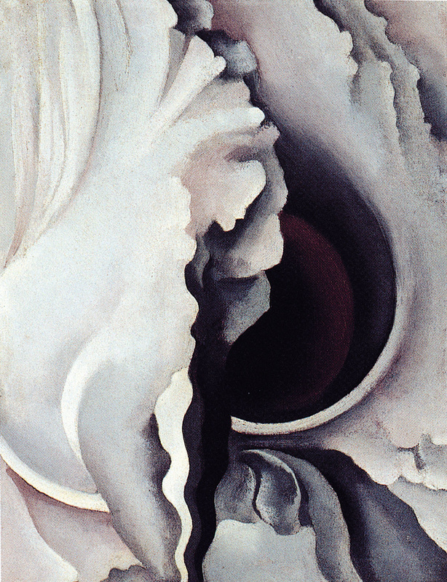
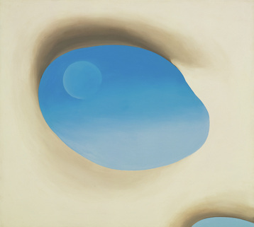
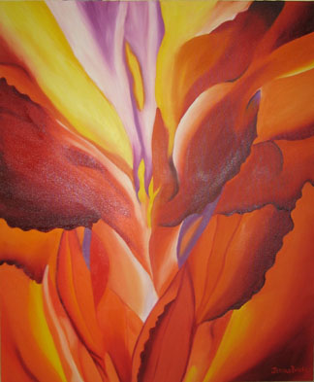
Georgia O’Keefe
Georgia O’Keeffe, The Black Iris, 1926, Oil on Canvas, 9x7 inches.
Georgia O’Keeffe, Pelvis IV, 1944. Oil on canvas, 36 x 40 inches.
Georgia O’Keeffe, Red Canna

Slide 5
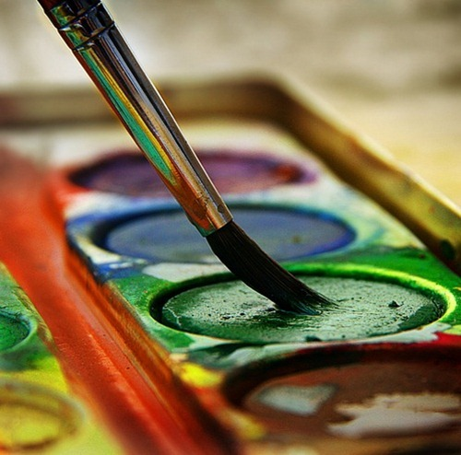
Sketchbook Assignment #2
Macro Object Drawing
Choose an object (from the art room or from your own personal collection). On the supplied paper, zoom in on an interesting area and draw it from observation, filling the entire paper. Your object should extend off the paper (not everything is showing). Using your selection of pencils, add values to (shade) your drawing completely.

