Slide 1
Still-Life in Charcoal

Slide 2
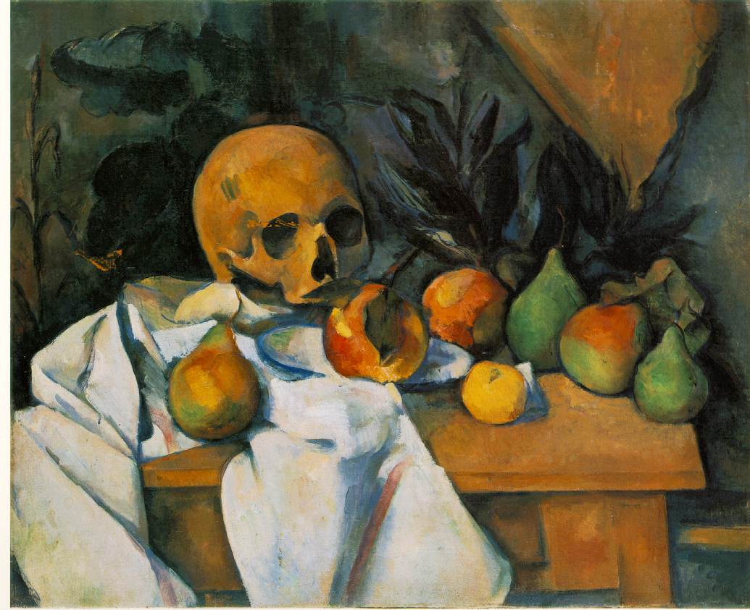
What is a Still-Life?
Still Life with Skull (Nature morte au crane)
Paul Cézanne
Still-Life- a drawing or painting featuring an arrangement of inanimate, everyday objects, whether natural objects (flowers, food, bones, etc.) or manufactured items (books, bottles, tableware, etc.)

Slide 3
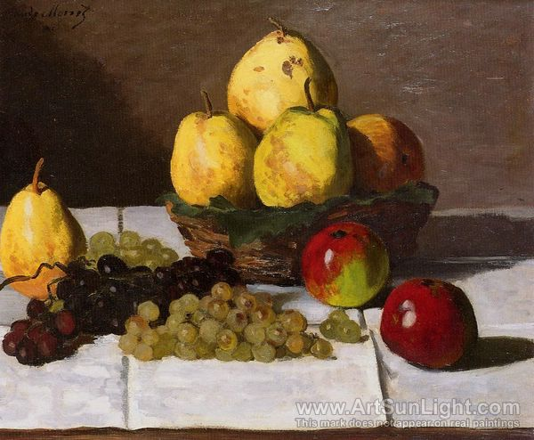
Things to think about…
View
Proportions
Values/Color
Light source
Reflections
Color
Texture
Still Life with Pears and Grapes, 1867
Claude Monet

Slide 4
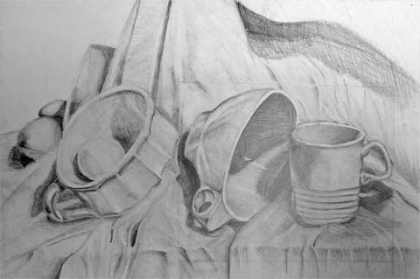
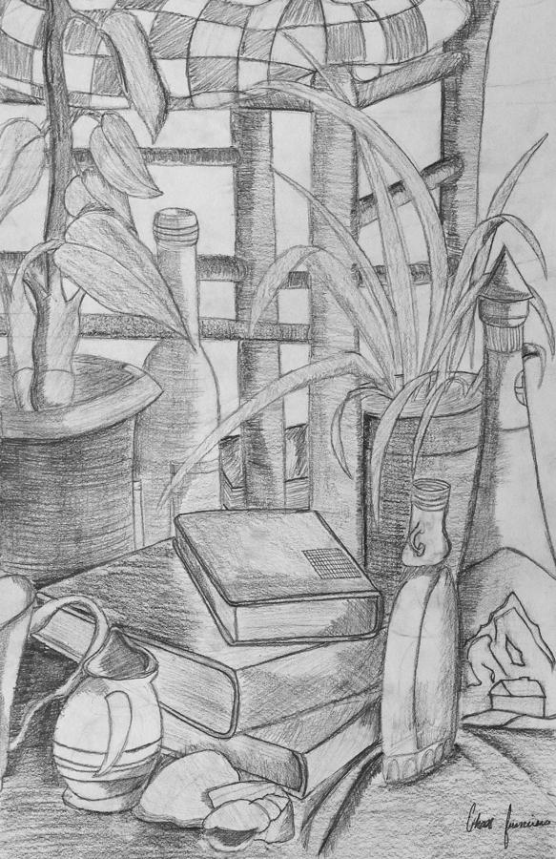
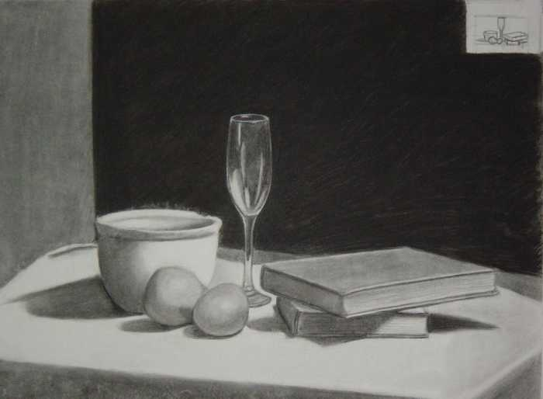
View

Slide 5
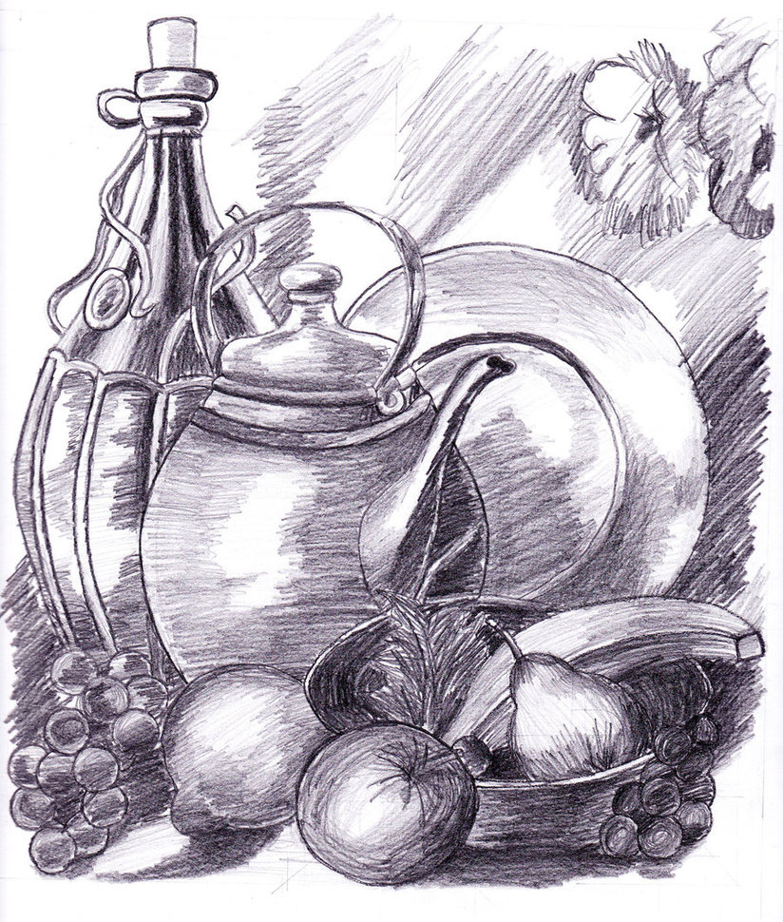
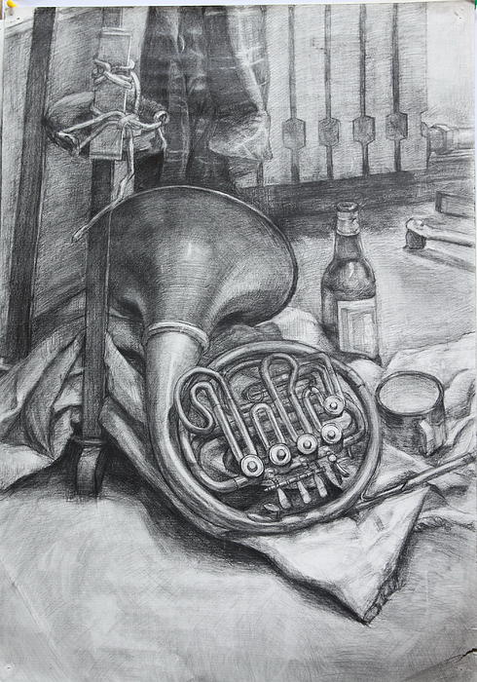
Proportion

Slide 6
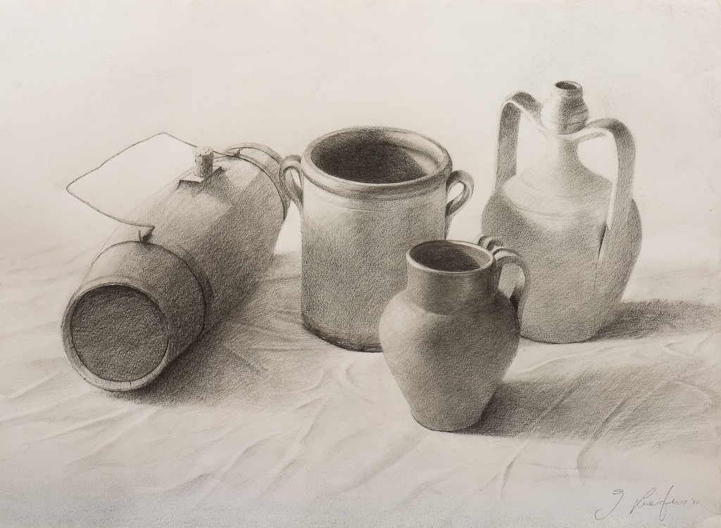
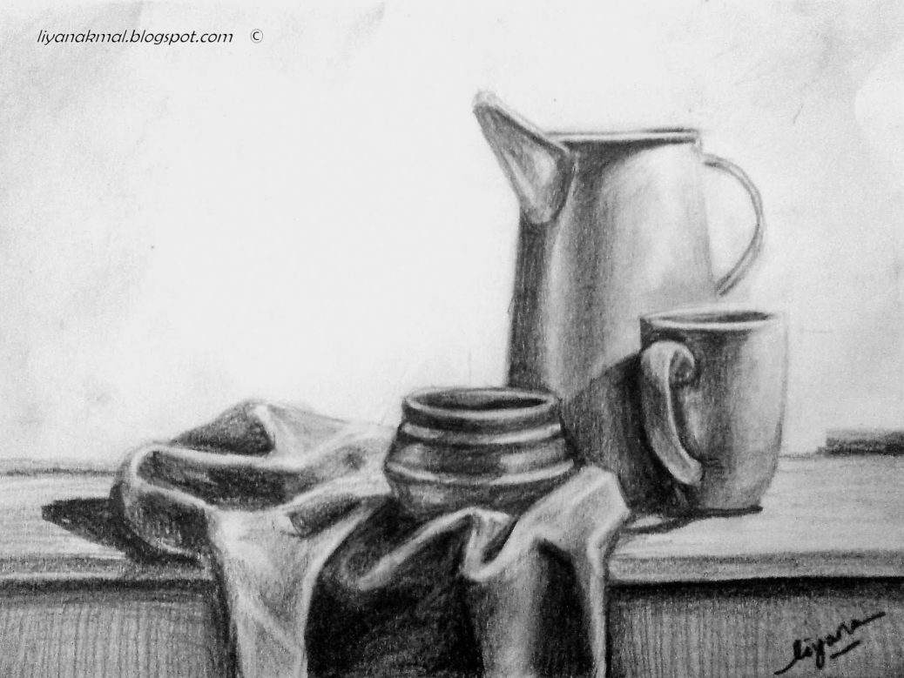
Value/Color

Slide 7
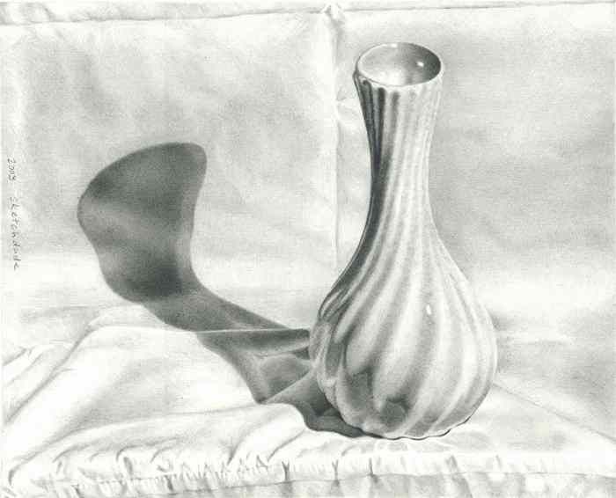
Light Source

Slide 8
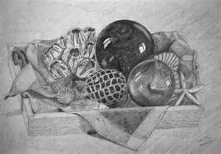
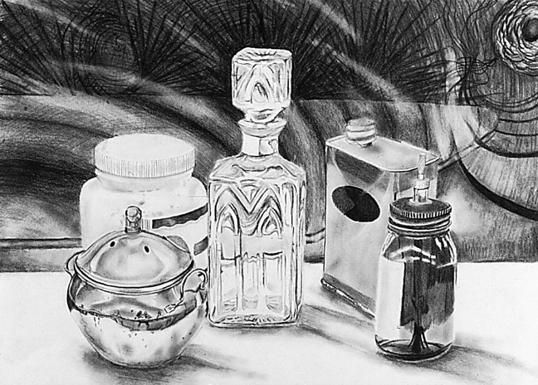
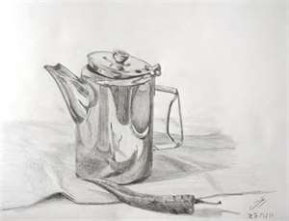
Reflections

Slide 9
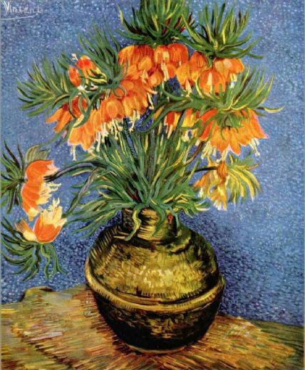
Texture
Vincent Van Gogh

Slide 10
Sketchbook Assignment # 3
Still-Life in Charcoal
Choose an interesting view to focus on from Still-Life. On 12x 18” manila paper, using only charcoal (black, gray and white), create a fully shaded drawing of what you see. Think about your composition...Where's your focal point? How will you show movement? Is it balanced? Remember to use various values, show any reflecting light, highlight your light source, portray all textures, etc.

