Slide 1
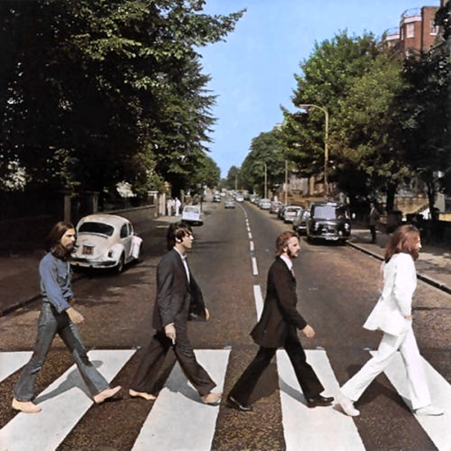
Album Cover Design

Slide 2
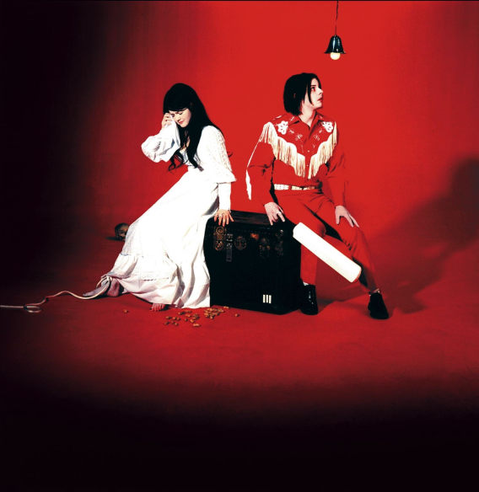
The Artist(s)

Slide 3
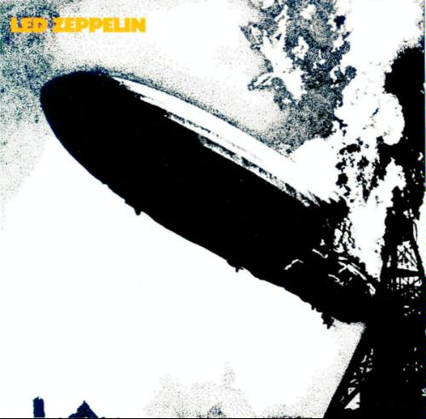
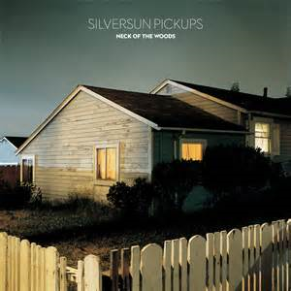
Imagery Relating to the Artist(s) or Title of Album

Slide 4
Including Random Imagery

Slide 5
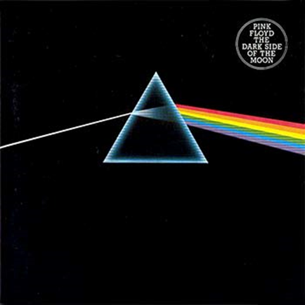
Designs

Slide 6
Drawing and Painting Assignment #5 Album Cover Design Choose your favorite vocal artist or band (of any genre). Brainstorm and sketch out at least 3 different album cover designs for that artist/band on the provided thumbnail sheet. Choose your best and begin! You may use colored pencils, oil pastels, paint or a mixture to create your design.

