Slide 1
Brushstrokes + Color + Emotion = ½ Portrait

Slide 2
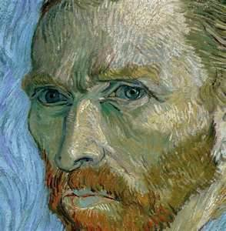
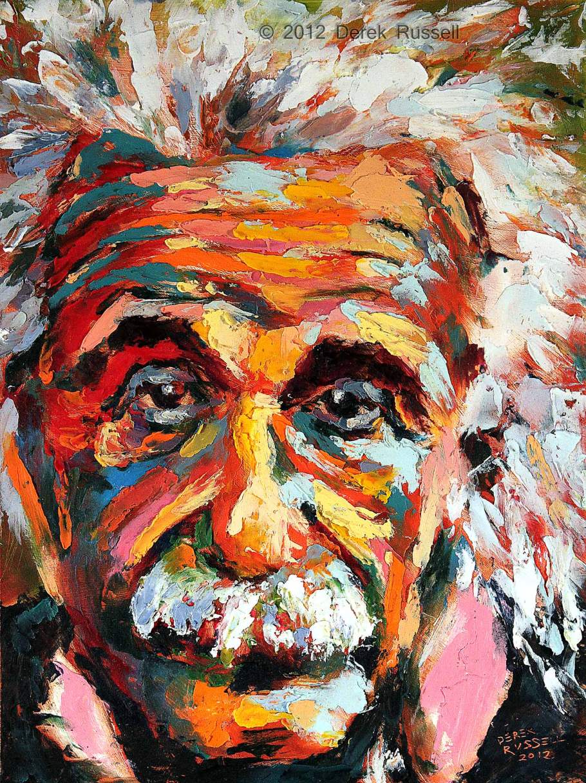
Brushstroke
Vincent Van Gogh
(Close up)
Creates texture
Allows for high contrast in values
Derek Russell

Slide 3
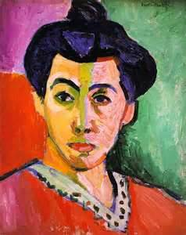
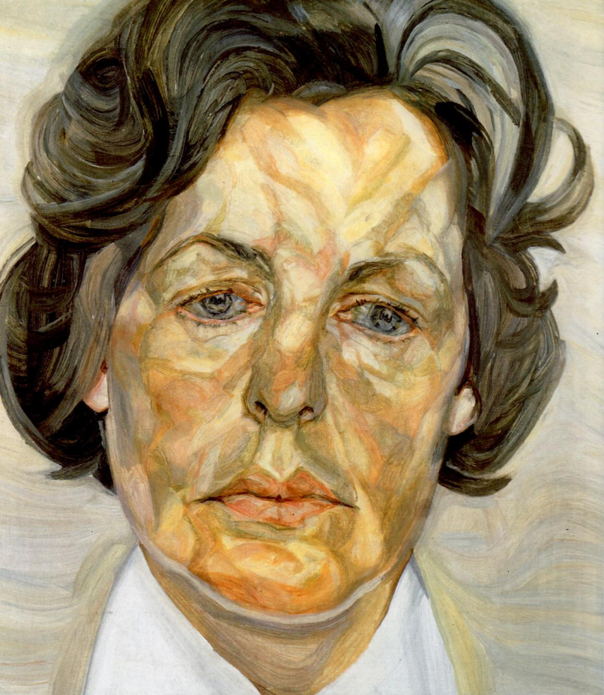
Color
Henri Matisse
Alice Neel
The human flesh is made up of more than one or two colors
You can use multiple colors and leave them unblended to create a realistic portrait

Slide 4
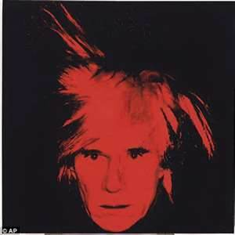
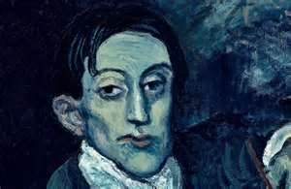
Emotion/Expression
Pablo Picasso
Andy Warhol
In addition to visual facial features, the use of brushstrokes and color can assist in portraying an emotion

Slide 5
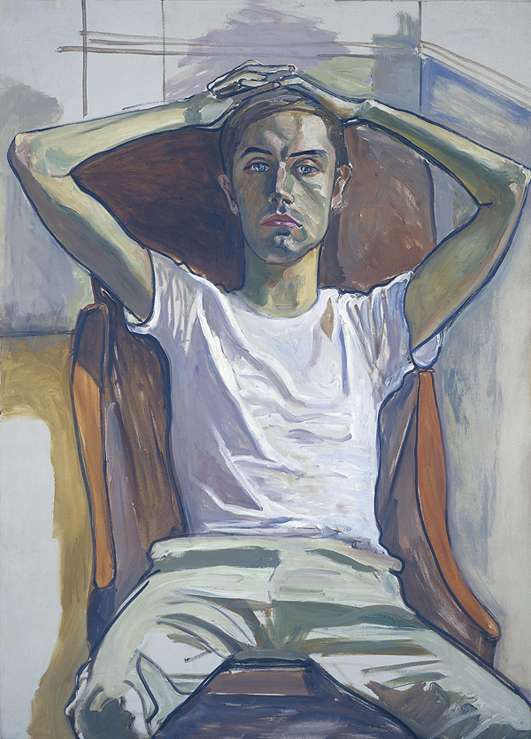
Sketchbook Assignment #1
½ Portrait
Find a portrait on the M drive
(McIntosh 2nd period) to use as an inspiration/reference and print off (in color). Then, find and print off an 8x10” portrait of someone who has had a positive impact on your life. Look for an artist (visual, vocal, or instrumental first. If you can’t find one, then think historically). Cut the portrait of your idol in half and glue onto the provided paper. Then use oil pastels and your inspirational picture to create the other half of your photo.

