Slide 1
Chapter 52 Section 1
Earth’s Climate Varies by Latitude and Season and is Changing Rapidly
By Allie Arpino

Slide 2
The most influential factor on the distribution of organisms is climate, the long-term, prevailing weather conditions in a given area.
Important Components of Climate:
-Temperature
-Precipitation
-Sunlight
-Wind
Two Different Scales of Climate Patterns:
-Macroclimate: patterns on the global, regional and landscape level.
-Microclimate: fine, localized patterns.

Slide 3
Global Climate Patterns
Global climate patterns are determined by solar energy and Earth’s movement of space.
The sun warms the atmosphere, land and water establishing the temperature variations, cycles of air and water movement and evaporation of water, which cause dramatic latitudinal variations in climate.

Slide 4
Regional and Local Effects on Climate
Climate patterns can be modified by many factors including seasonal variation, large bodies of water, and mountain ranges.

Slide 5
Seasonality
Earth’s tilted axis and passage around the sun cause strong seasonal cycles. (Figure 52.4)
Besides the changing cycles in day length, solar radiation and temperature, the change in the angle of the sun affects local environments.
Also, seasonal changes in wind patterns alter ocean currents, sometimes causing old water to rise from deep ocean layers.

Slide 6
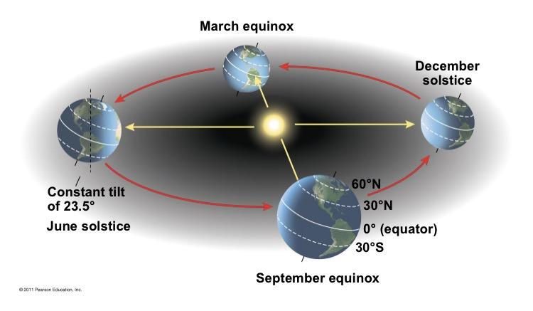

Slide 7
Bodies of Water
Ocean currents influence climate along the coasts of continents by heating or cooling overlaying air masses. (52.5)
Because of the high specific heat of water, oceans and larger lakes tend to moderate the climate of the land nearby.

Slide 8
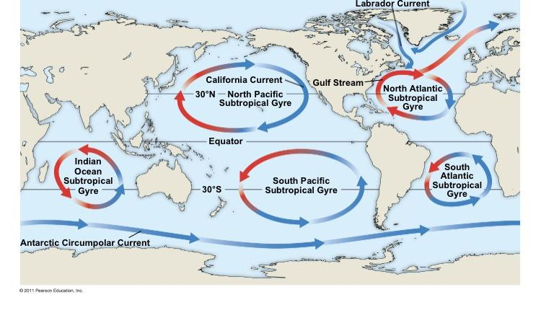

Slide 9
Mountains
Mountain influence air flow over land.
When warm, moist air approaches a mountain, the air rises and cools, releasing moisture on the windward side of the mountain. (FIgure 52.6)
Mountains also affect the amount of sunlight that reaches an area and thus controls the temperature and rainfall.
These physical differences also influence species.

Slide 10
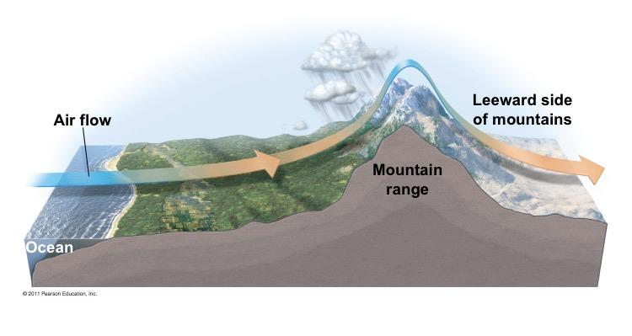

Slide 11
Microclimate
Features that influence microclimate:
-shadecasting
-altering evaporation from soil
-changing wind patterns
-forest trees
Cleared areas typically experience greater temperature extremes than the forest interior.
Every environment on Earth is characterized by small scale differences in abiotic (nonliving) factors that influence the distribution of organisms.
These factors include:
-temperature
-light
-water
-nutrients

Slide 12
Global Climate Change
Any large scale change in Earth’s climate affects the biosphere
Ex. Burning of fossil fuels and deforestation (adding more carbon dioxide to the air and causing the Earth to warm).
A way to predict future climate change is to look back at the changes that have occurred since the last ice age. Using this approach, Ecologist have tried to answer whether or not plants and other species will be able to keep up with the warming Earth. (insert 52.7)

Slide 13
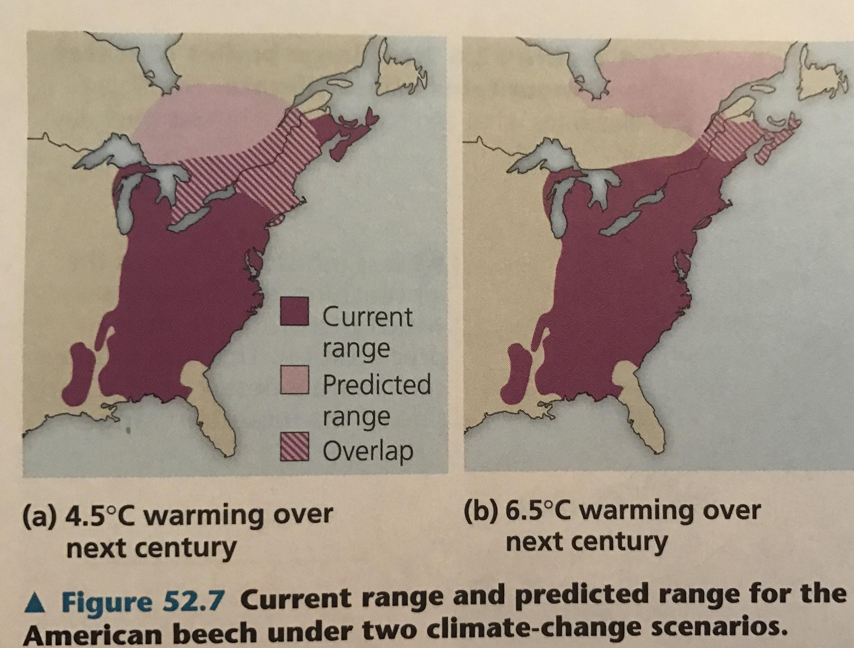

Slide 14
Global Climate Change (continued)
Changes in the distribution of species are evident in groups of terrestrial, marine and freshwater organisms. (Figure 52.8)
The observation that many species are on the move during climate change illustrates the importance of climate in determining species distributions.

Slide 15
