Slide 1
Concept 52.2:
The structure and distribution of terrestrial biomes are controlled by climate and disturbance
March 27, 2017
By: Christina Burns

Slide 2
BIOMES
Biomes are major life zones characterized by vegetation type or by the physical environment
Climate is a very important factor when determining why terrestrial biomes are found in certain areas

Slide 3
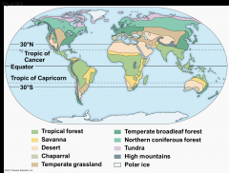
Climate and Terrestrial Biomes
Terrestrial biomes show strong latitudinal patterns as a result of climate

Slide 4
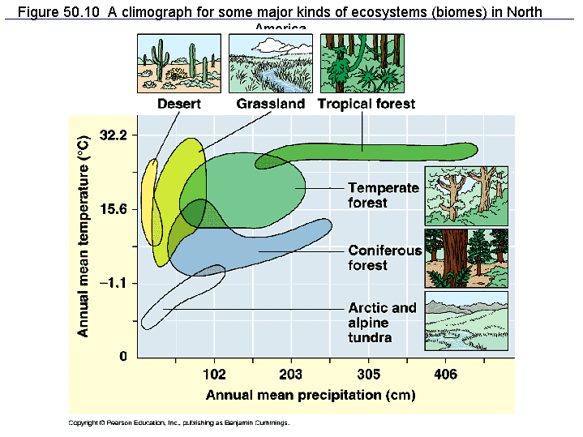
Climate and Terrestrial Biomes
One way to highlight the importance of biomes is to construct a climograph. Climographs plot the annual mean temperature and precipitation in a particular area.

Slide 5
General Features of Terrestrial Biomes #1
Terrestrial biomes are often named for major physical or climatic features and for vegetation
For example, temperate grasslands are generally found in middle latitudes where the climate is more moderate
Biomes are characterized by microorganisms, fungi, and animals adapted to that specific area
Temperate grasslands are more likely to be populated by large mammals
Terrestrial biomes usually grade into one another, without sharp boundaries
The area of intergradation, know as an ecotone, may be wide or narrow

Slide 6
General Features of Terrestrial Biomes #2
Vertical layering is an important feature of terrestrial biomes
The shapes and sizes of plant are crucial in that they define that layering
In a forest, it might consist of an upper canopy, low-tree layer, shrub understory, ground layer of herbaceous plants, forest floor, and root layer
The layering of vegetation in biomes provides a variety of diverse habitats for animals

Slide 7
Disturbance and Terrestrial Biomes
Disturbance is an event such as a storm, fire, or human activity that changes a community
A disturbance can remove organisms from its biomes and alter resource availability
For example, frequent fires can potentially kill woody plants and prevent a savanna from becoming the woodland that the climate alone would support.
Hurricanes can create openings for new species in tropical and temperate forests
Biomes are very dynamic and as a result of disturbances, they can exhibit extensive patchiness, with several different communities represented in a single area
Many different aspects of a biome depend on periodic disturbance
Natural wildfires are integral components of grasslands and many coniferous forests

Slide 8
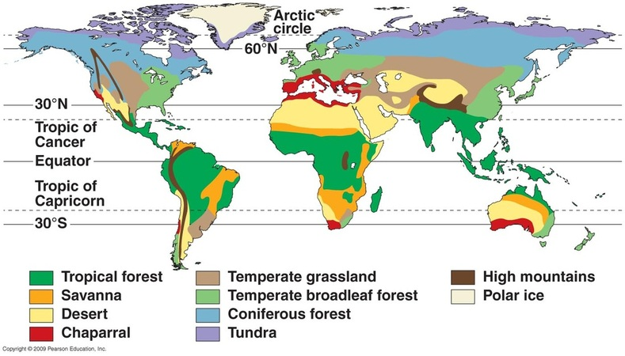
TERRESTRIAL BIOMES
Terrestrial biomes can be characterized by distribution, precipitation, temperature, plants, and animals

Slide 9
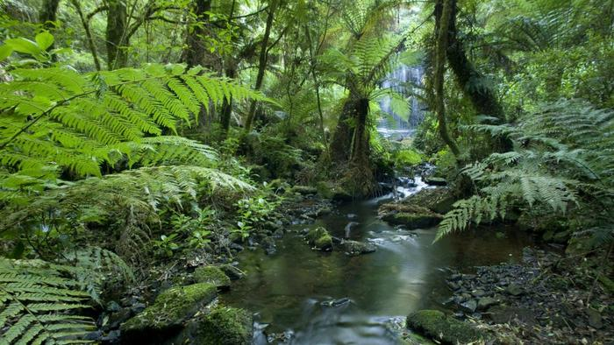
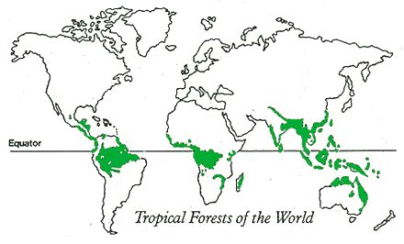
Tropical Rainforest
Distribution is in equatorial and subequatorial regions
In tropical rainforests, rainfall is relatively constant, while in dry tropical forests, precipitation is highly seasonal.
Temperature is high year round, averaging 25-29 degrees celsius with little seasonal variation
Vertically layered, competition for light is intense
Home to millions of species
Rapid human population growth is now destroying many forests

Slide 10
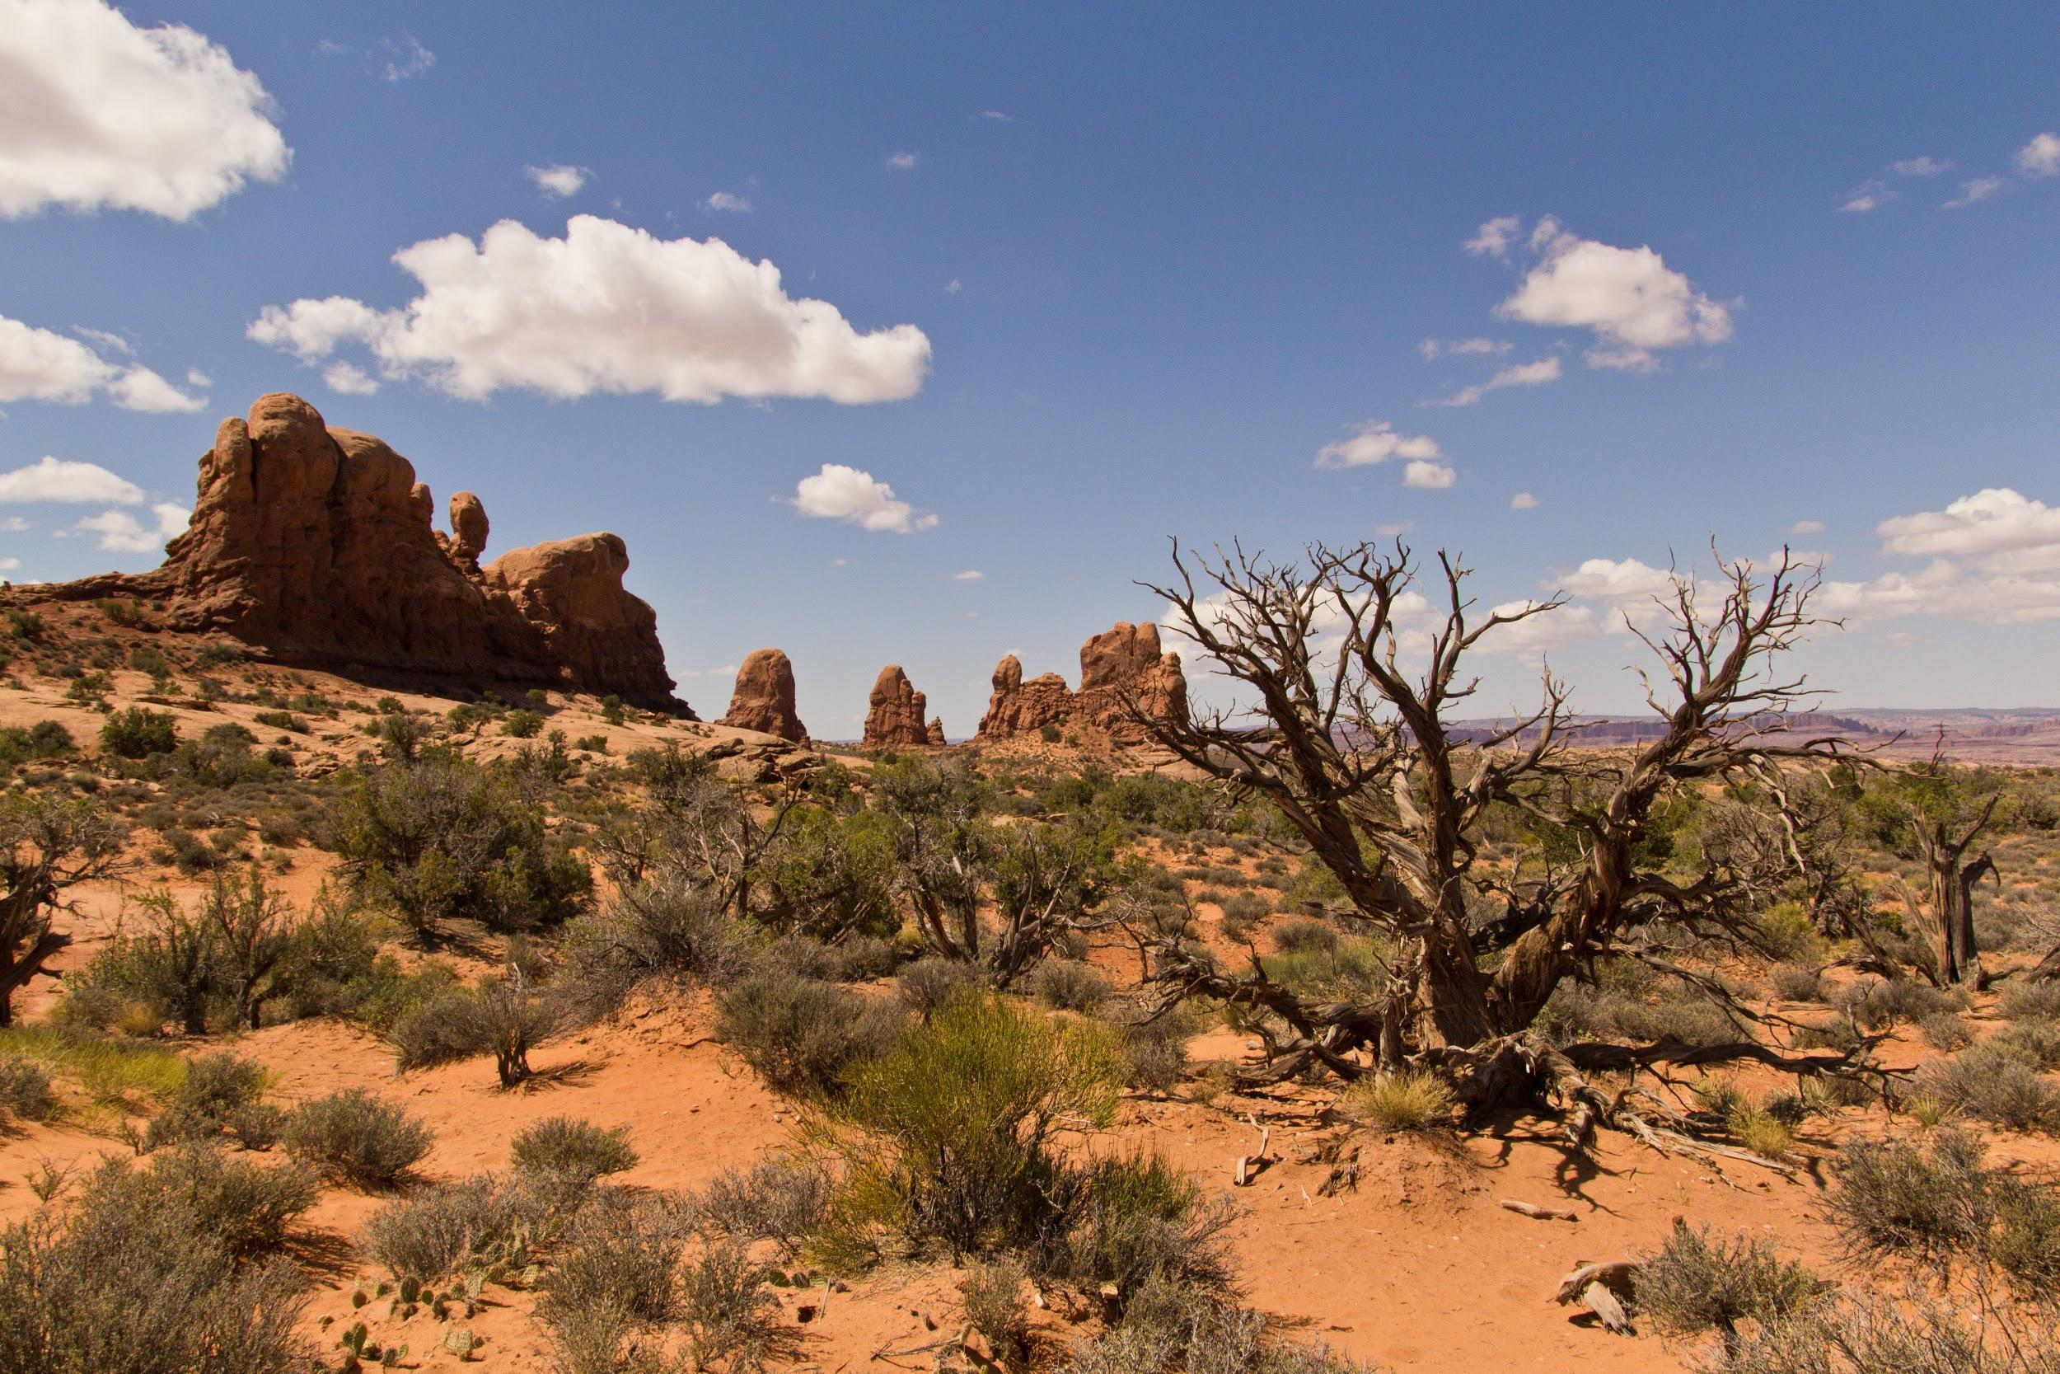
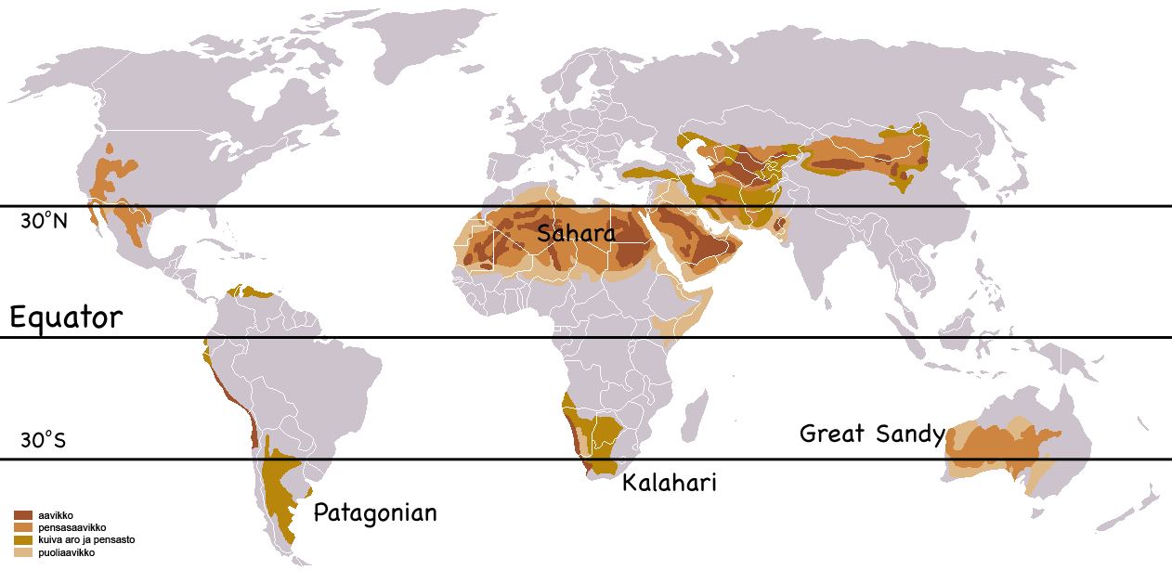
Desert
Deserts occur in bands near 30 degrees north and south latitude
Precipitation is low and highly variable, generally less than 30 cm per year
Deserts may be hot or cold
Desert plant adaptations include heat tolerance, water storage, and reduced leaf surface area
Common desert animals include: snakes, lizards, scorpions, etc.
Urbanization and conversion to irrigated agriculture have reduced the natural biodiversity of some deserts

Slide 11
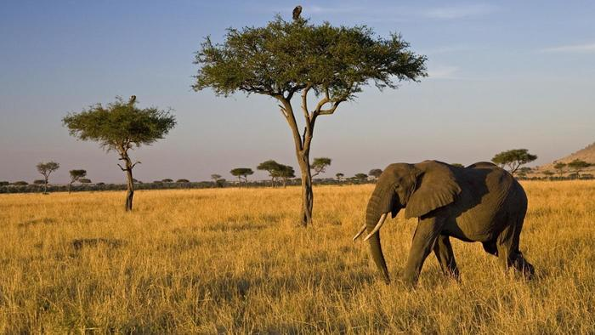
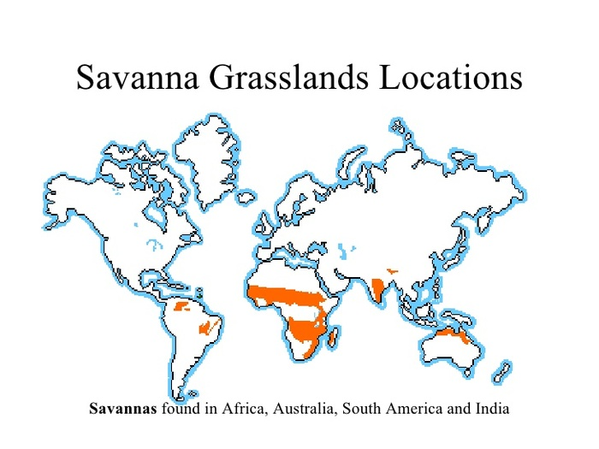
Savanna
Equatorial and subequatorial regions
Savanna precipitation is seasonal
Temperature averages (24-29 degrees celsius) but is more seasonally variable than in the tropics
Grasses and forbs make up most of the savanna
Home of large plant-eating mammals and predators. The dominant herbivores are insects
Fires set by humans may help this biome, though overly frequent fires reduce tree regeneration

Slide 12
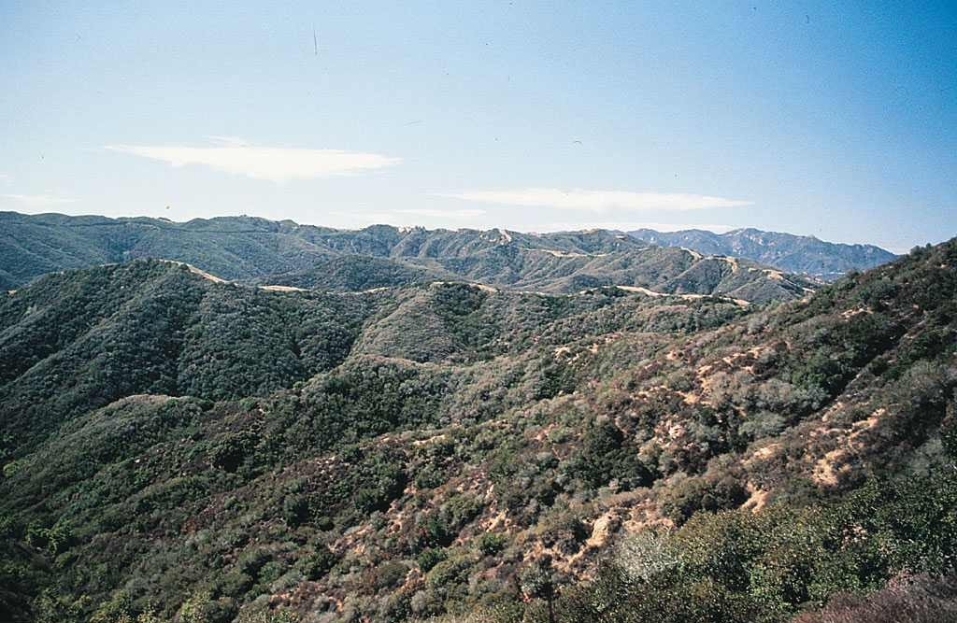
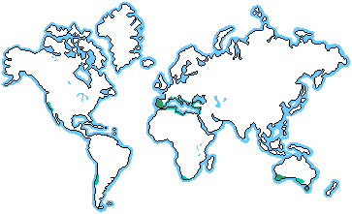
Chaparral
Occurs in mid-latitude coastal regions
Precipitation is highly seasonal, with rainy winters and dry summers
Summers are hot (30 degrees celsius +); fall, winter, and spring are cool
Chaparral is dominated by shrubs, small trees, grasses, and herbs
Animals include deer, goats, birds, etc.
Chaparral areas have been heavily settled and reduced through conversion to agriculture and urbanization

Slide 13
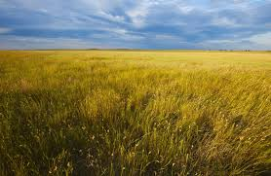
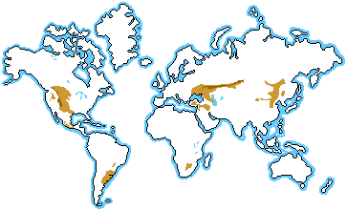
Temperate Grassland
Temperate grasslands are found on many continents
Precipitation is highly seasonal
Winters are cold and dry; summers are hot and wet
The dominant plants, grasses, and forbs are adapted to droughts and fire
Native mammals include large grazers such as bison and wild horses.
Most grasslands have been converted to farmland

Slide 14
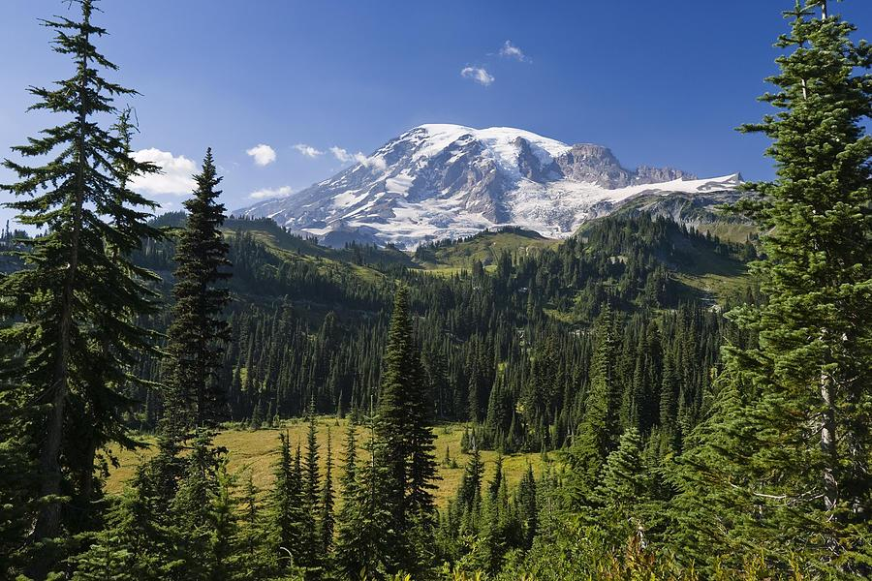
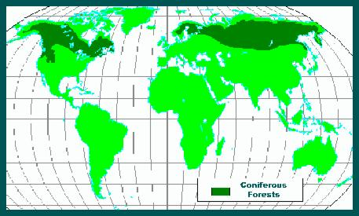
Northern Coniferous Forest
The northern coniferous forest, or taiga, is the largest terrestrial biome and spans across North America and Eurasia to the edge of the arctic tundra
Precipitation varies
Winters are cold; summers may be hot
Conifers such as pine dominate
Animals include migrant and resident birds and large mammals
Some forests are being logged at a growing rate

Slide 15
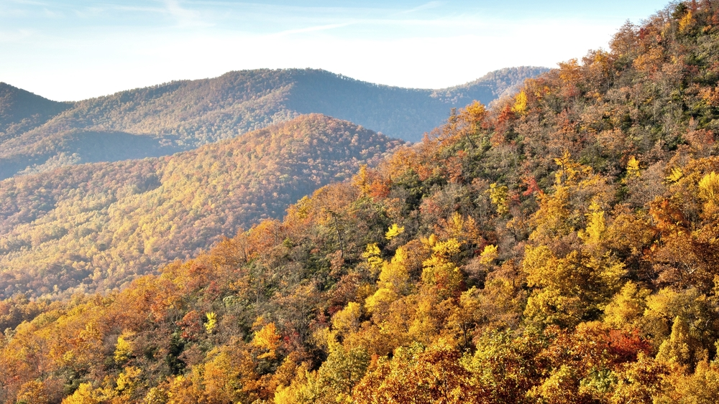
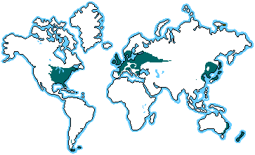
Temperate Broadleaf Forest
Temperate broadleaf forest is found mainly at mid-latitudes in the Northern Hemisphere
Significant amounts of precipitation fall during all seasons
Winter temperatures average about 0 degrees celsius; summers are hot and humid
Has distinct vertical layers. Dominant plants are deciduous trees
Mammals, birds, and insects make use of the forest’s vertical layers
These forests have been heavily settled on

Slide 16
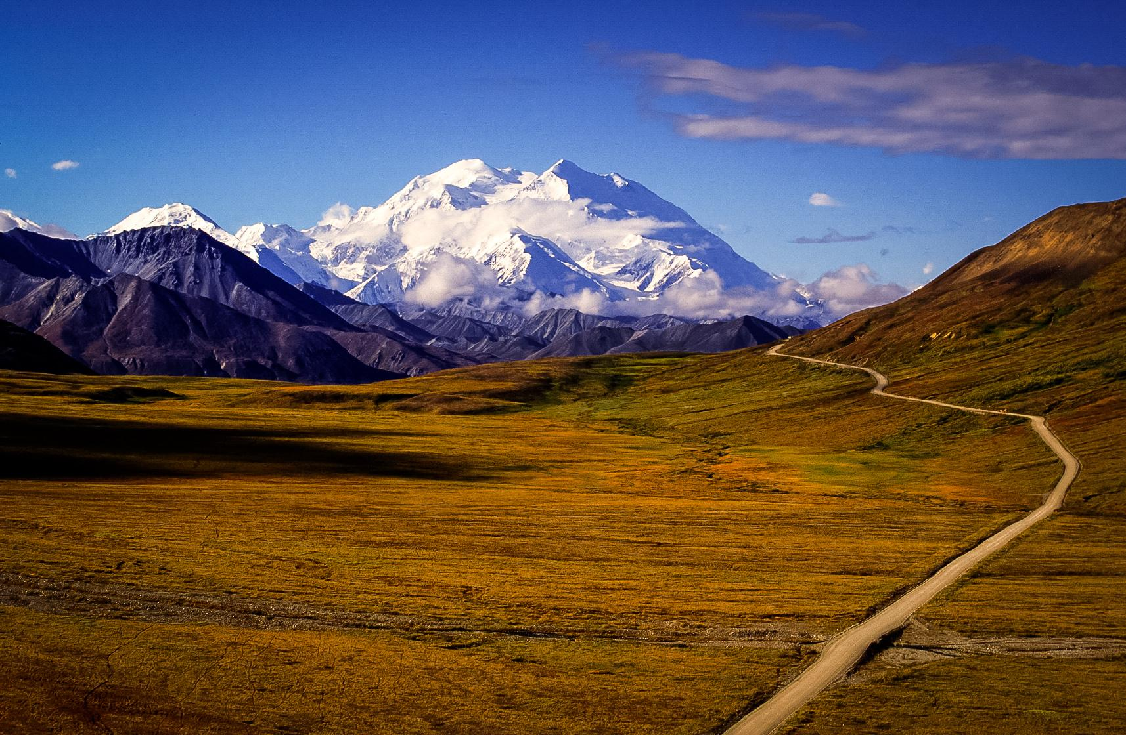
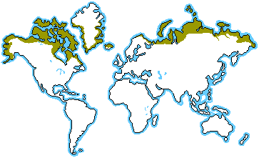
Tundra
Tundra covers expansive areas of the arctic; alpine tundra exists on high mountaintops at all latitudes
Precipitation averages from 20 to 60 cm annually in arctic tundra but may exceed 100 in alpine
Winters are cold; summers are relatively cool
Permafrost restricts growth of plant roots
Mammals include musk oxen, caribou, reindeer, bears, etc.
Tundra is sparsely settled on but has become the focus of significant mineral and oil extraction

Slide 17
The End
Concept 52.2: The structure and distribution of terrestrial biomes are controlled by climate and disturbance

