Slide 1
Interactions between organisms and the environment limit the distribution of species (52.4)
101

Slide 2
Examining how ecologists determine what factors control the distribution of species
Species distributions are a consequence of both ecological and evolutionary interactions throughout time.
The differential survival and reproduction of individuals that lead to evolution occur in ecological time – used to identify times of changing environments.
Through natural selection, organisms adapt to their environment over the time frame of many generations, in evolutionary time.
Ex: Events in ecological time have lead to the evolution of selection for beak depth in Galapagos finches. On the islands, finches with larger, deeper beaks were better able to survive during a drought because they could eat the large, hard seeds that were available. Finches with shallower beaks, which required smaller, softer seeds that were in short supply, were less likely to survive and reproduce. Because beak depth is hereditary in Finches, the generation of finches born after the drought had beaks that were deeper than those of previous generations.

Slide 3
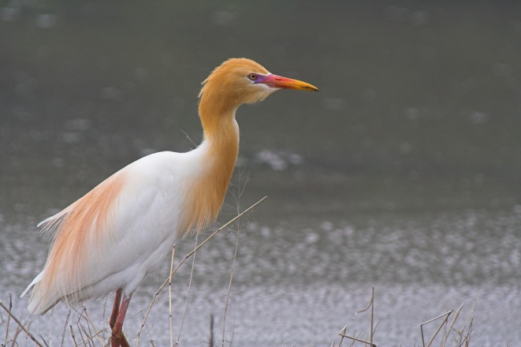
What factors determine distribution?
Ecologists must focus on both biotic and abiotic factors.
Dispersal contributes greatly to the global distribution of organisms, it is the movement of individuals or gametes away from their area of origin or from centers of high population density.
The Cattle Egret used to only be located in Africa and Southwestern Europe, but were able to cross the Atlantic Ocean in the late 1800s, and today they have breeding populations from South America, to as far north as Southern Canada. Likewise, America doesn’t have kangaroos because they are restricted by barriers.
Long-distance dispersal could lead to adaptive radiation – the rapid evolution of an ancestral species into new species.
Species have natural ranges, but this doesn’t mean they are confined to those ranges, and some organisms do not occupy all of their potential range.

Slide 4
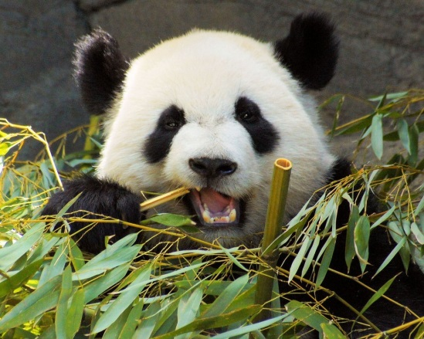
Biotic Factors
Other species, including what they eat. A species can’t disperse everywhere if it eats certain things in a certain area. (Pandas and bamboo)
The presence of pollinators, food recourses, parasites, pathogens, and competing organisms can act as biotic limitations.
Humans introducing exotic predators or pathogens into new areas could wipe out native species.

Slide 5
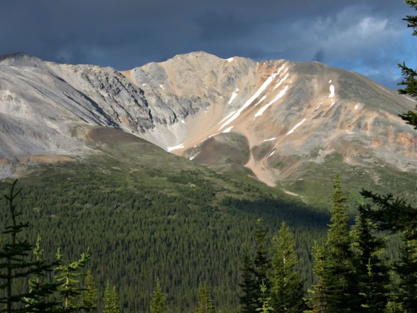
Abiotic factors
Temperature – effects biological processes. Cells can rupture in very cold weather, and an organisms proteins denature at very hot temperatures. Most organisms function best within a specific range of temperature. In temperatures not normal to an organism, their body wastes energy trying to regulate their internal temperature.
Water and Oxygen – Water availability, less water = less life. Oxygen diffuses slowly in water, so it can be low in certain aquatic systems and soil, limiting cellular respiration and other physiological processes.
Salinity - The salt concentration of water in in the environment affects the water balance of organisms through osmosis. Usually very high salt concentrations have very few species of plants or animals.
Sunlight - Sunlight absorbed by photosynthetic organisms provide the energy for the rest of the ecosystem, too little sunlight can limit the distribution of photosynthetic species. Too much sunlight can limit survival, like in deserts, high light levels can increase temperature stress if animals and plants can’t avoid the light and cool themselves off. Also, at high elevations, the sun’s rays are more likely to cause damage to DNA and proteins because the atmosphere is thinner, absorbing less UV radiation. This is why trees can’t grow past certain elevations, resulting in tree lines on some mountains.
Rocks and soil - PH, mineral composition, and physical structure of rocks and soil limit distribution of plants and thus the animals that feed on them.

Slide 6
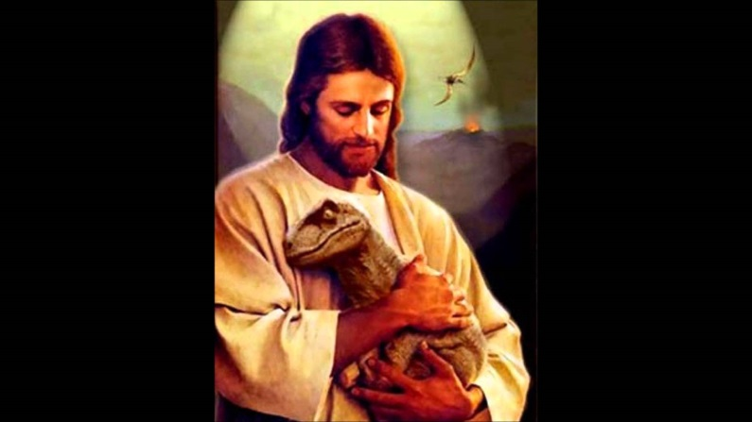
So…
Plants can’t just grow wherever they are planted, and animals can’t live wherever they want. The distribution of species may be limited on dispersal, the movement of individuals away from their area of origin; behavior; biotic factors; and abiotic factors.

