Slide 1
53.1
Joe Decker

Slide 2
Dynamic biological processes influence population density, dispersion, and demographics
A Population is a group of individuals of a single species living in the same general area.

Slide 3
Density: A Dynamic Perspective
Almost impossible to count all individuals within a population to calculate density and population size
Instead, ecologists use a variety of sampling techniques to estimate these quantities
Mark-recapture technique, county population in an area and set up a proportion, estimate based on signs such as nests, fecal droppings, tracks, etc.
Directly related to number of individuals in a population-not static
Immigration- moves individuals into a population
Death and emigration- move individuals out of a population

Slide 4
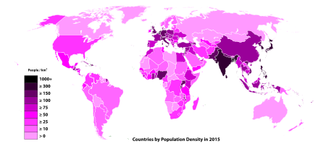

Slide 5
Patterns of Dispersion
Clumped- individuals are aggregated in patches where conditions are favorable
Uniform- evenly spaced pattern of dispersion, plants secrete chemicals that inhibit growth, territorial animals
Random- unpredictable spacing that occurs where there are no strong attractions or rejections

Slide 6
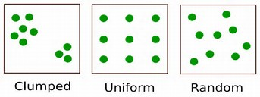

Slide 7
Demographics
Demography is the study of the vital statistics of populations and how they change over time.

Slide 8
Life Tables
Age-specific summaries of the survival pattern of a population. Was adapted to study populations as a whole
Cohort- group of individuals of the same age
Death rates in populations can be determined from them by looking at the age members of the populations died at

Slide 9
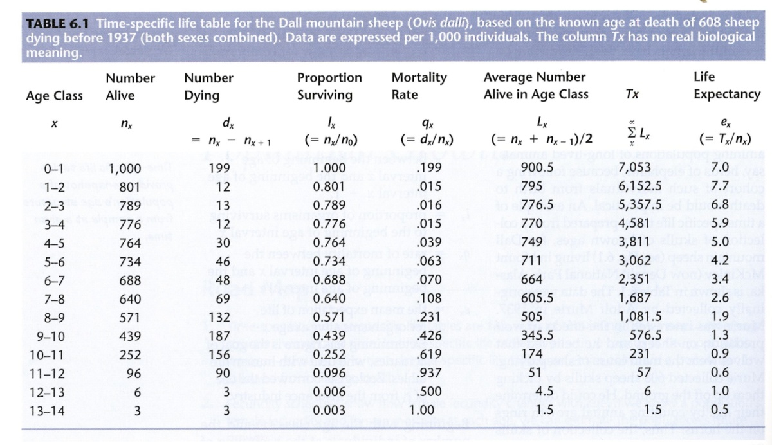

Slide 10
Survivorship Curve
A graphic method of representing some of the data in a life table is survivorship curve, a plot of the proportion or numbers in a cohort that are still alive at each age.
Type I starts flat and drops as death rate increases among cohort
Type II constant death rate
Type III reflects steep death rates at a young age and flattens out as the cohort gets older

Slide 11
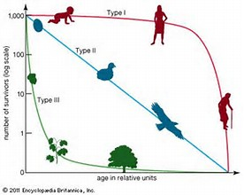
v

Slide 12
Reproductive Rates
A reproductive table, a fertility schedule, is an age specific summary of the reproductive rates in a population.
Measures reproductive output of a cohort until death
Only female offspring and parents are considered for the data
High reproductive rate requires ideal growth conditions in order to increase population

