Slide 1
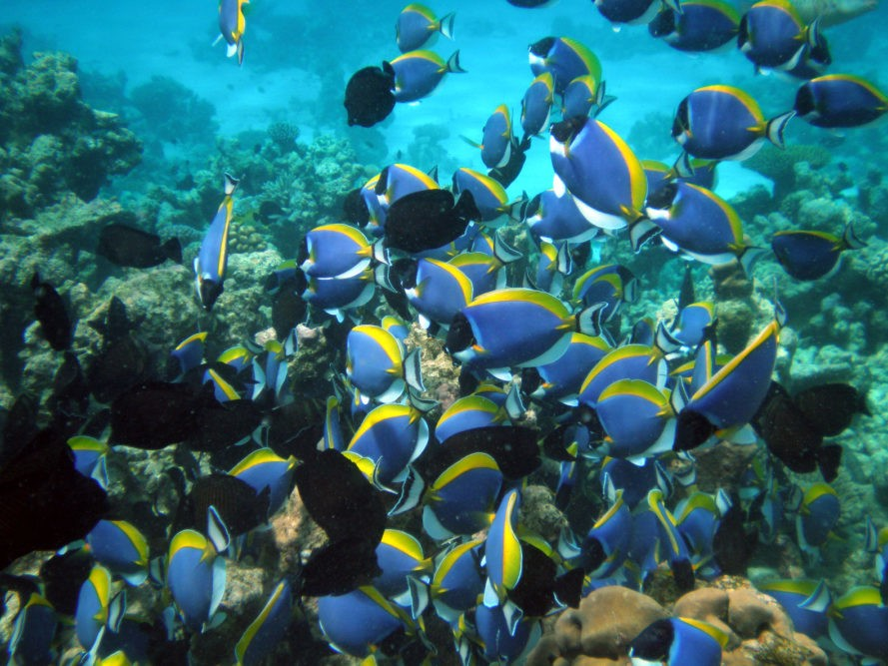
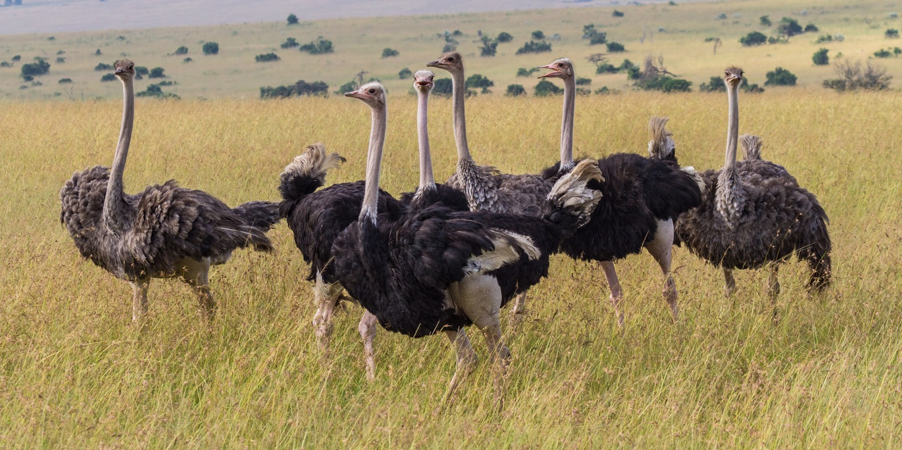
Population Ecology
53.1
By Camryn England

Slide 2
Chapter 53.1
What is Population Ecology?
The study of populations in relation to their environment. Population Ecology explores:
How biotic and abiotic factors influence density
Distribution
Size
Age Structures of populations

Slide 3
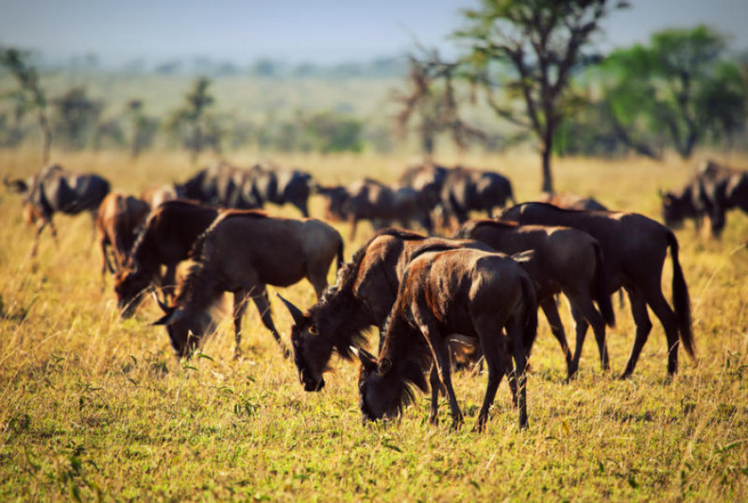
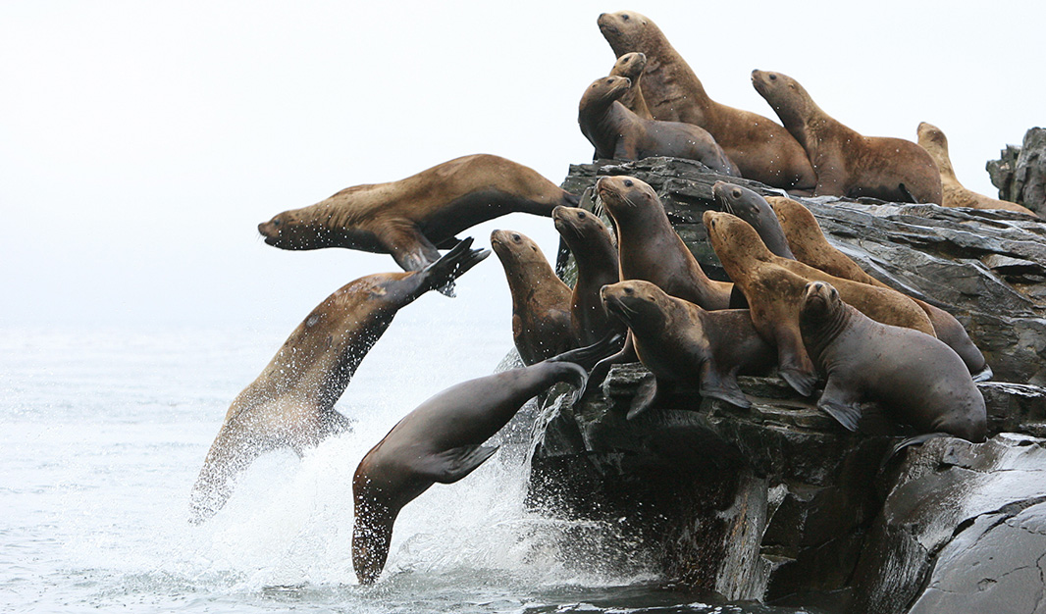
Chapter 53.1
A population is a group of individuals of a single species living in the same general area.
Members of a population rely on the same food sources, are affected by the same environmental factors, and are likely to breed and interact with one another.

Slide 4
Density and Dispersion
The density of a population is the number of individuals per unit area or volume
Ex: The number of oak trees per square kilometer in the Minnesota county or the Escherichia Coli Bacteria per square millimeter in a test tube.

Slide 5
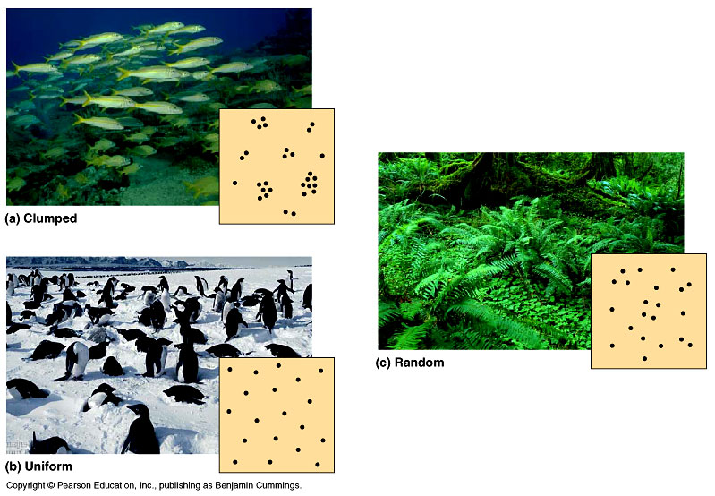
Density and Dispersion
Dispersion is the pattern of spacing among individuals within the boundaries of a population.

Slide 6
Density
In most cases it is impractical or impossible to count all the individuals in a population.
Instead, Ecologists use a variety of sampling techniques to estimate density and total population sizes.

Slide 7
Density
For example, an Ecologist might:
Count the number of oak trees in several randomly located 100x100 m plots
Calculate the average density in the plots
Then extend the estimate to the population size in the entire area.

Slide 8
Density
Density changes as individuals are added or removed from a population.
Addition occurs through birth and immigration, the influx of new individuals from other areas.
Factors that remove individuals are death and emigration, the movement of individuals into other locations.

Slide 9
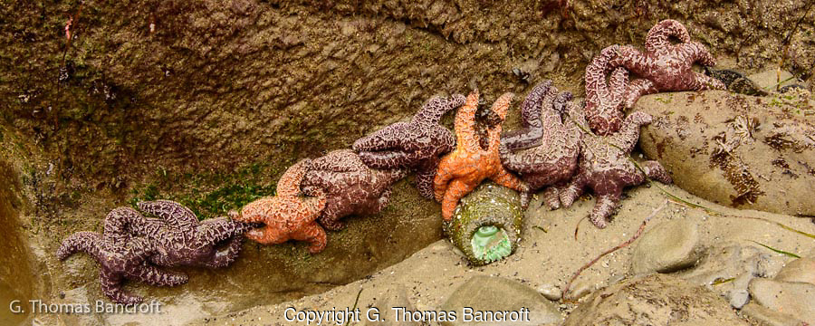
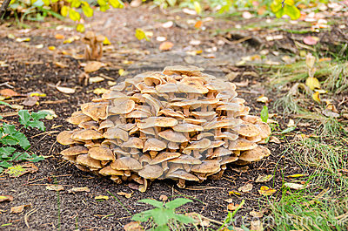
Patterns of Dispersion
The most common pattern of dispersion is clumped, in which individuals are aggregated in patches.
Ex: Plants and fungi are often clumped where soil conditions favor germination and growth.

Slide 10
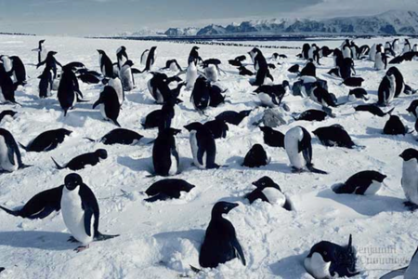
Patterns of Dispersion
Another pattern of dispersion is uniform. A uniform, or evenly spaced, pattern of dispersion may result from direct interactions between individuals in the population.
This shows territoriality, the defense of a bounded physical space, between individuals.

Slide 11
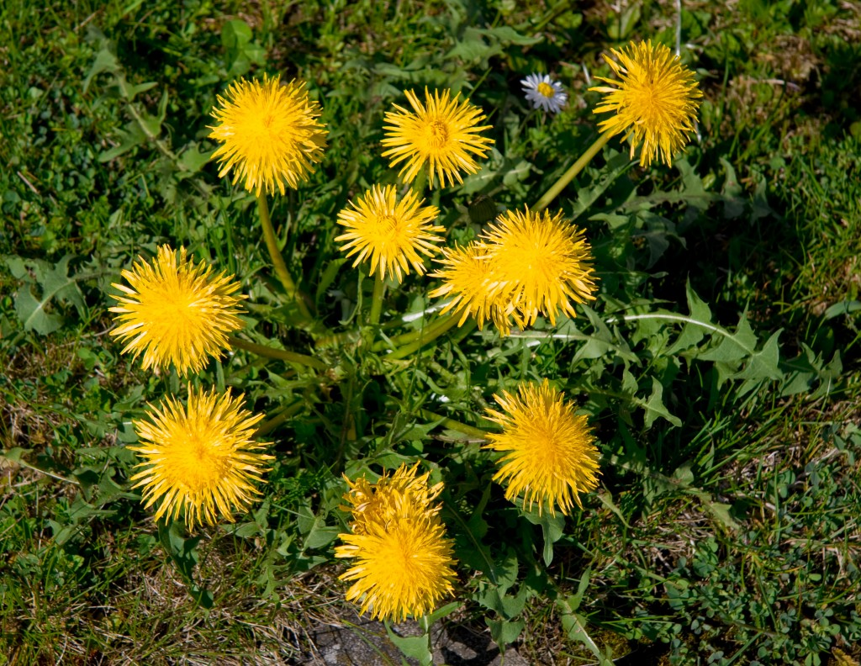
Patterns of Dispersion
Lastly there is random dispersion.
The position of each individual in a population is independent of other individuals.

Slide 12
Demographics
Demography is the study of the vital statistics of populations and how they change over time. Of particular interest to demographers are the birth rates and death rates.
Demographers use life tables to determine how long, on average, an animal in a population could be expected to live.

Slide 13
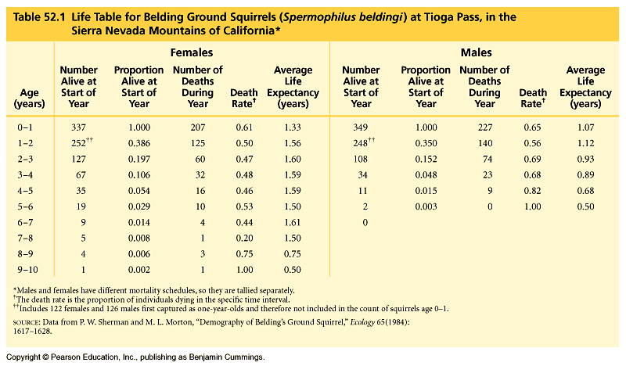

Slide 14
Survivorship Curves
A graphic method of representing some of the data in a life table is a survivorship curve, a plot of the proportion or numbers in a cohort (group of individuals the same age) still alive at each age.

Slide 15
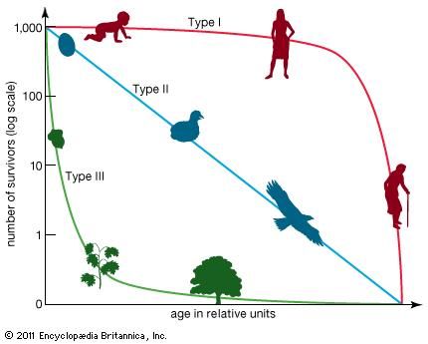

Slide 16
Reproductive Tables
A reproductive table or fertility schedule, is an age specific summary of the reproductive rates in a population. It measures the reproductive output of a cohort from birth until death.
Ex: Squirrels have a litter of 2-6 young once a year for less than a decade. Whereas oak trees drop millions of acorns for tens or hundreds of years.

Slide 17
