Slide 1
Concept 53.2
The Exponential Model

Slide 2
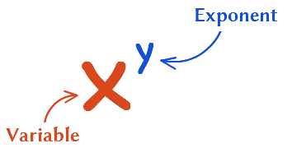
The Exponential Model: An Invaluable Tool
The Exponential Model describes population growth in an idealized, unlimited environment

Slide 3
Reproduction in a Population
Different species have vastly different rates of reproduction in some instances
For example, some bacteria species can reproduce every 20 minutes, while some animals like elephants can have a maximum of 6 offspring per their 100 year lives

Slide 4
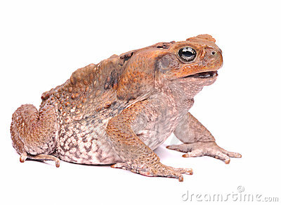
Why do we care?
Studying population growth in an ideal, unlimited environment reveals how fast a population is capable of growing and the conditions under which rapid growth might actually occur

Slide 5
Here comes the Math

Slide 6
Capita Rate of Increase
Change in population = Births + Immigrants - Deaths - Emigrants Size entering the leaving the
Population Population

Slide 7
Gettin more complex now
N N = change in population size _____ = B - D t t = change in time
B = Births
D = Deaths

Slide 8
Birth Rate Per Capita
B = bN B = Births per year
b = Birth rate
N = Population

Slide 9
Death rate Per Capita
D = mN D = Deaths
m = mortality rate
N = population

Slide 10
Now they start putting formulas together
HANG ON TIGHT

Slide 11
formulos
N N = change in population size _____ = bN - mN t t = change in time
R = b - m R = Rate of Increase m = mortality decrease
b = Birth Increase

Slide 12
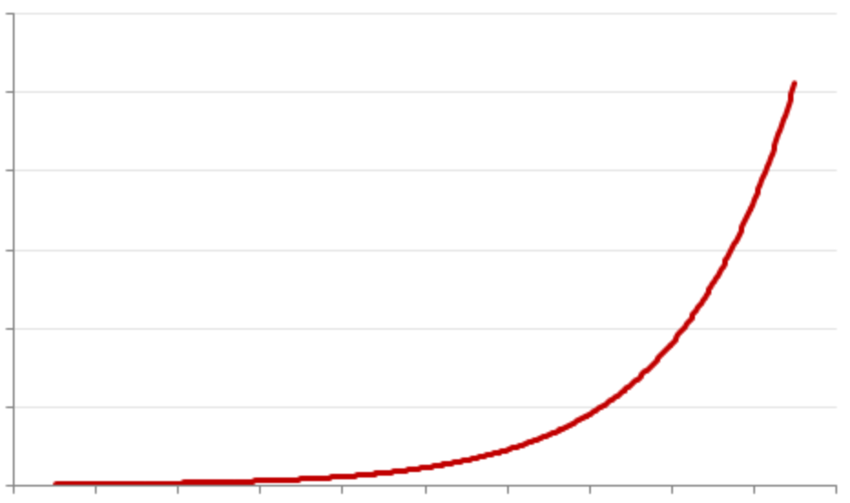
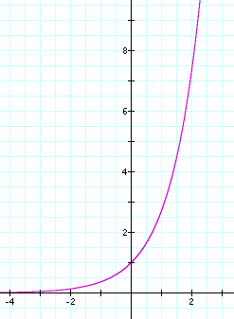
J Curve

Slide 13
Applying what we know

Slide 14
Thanks for having me folks
Now ya know

