Slide 1
The Exponential model describes population growth in an idealized, unlimited environment
By Madison Johnstone

Slide 2
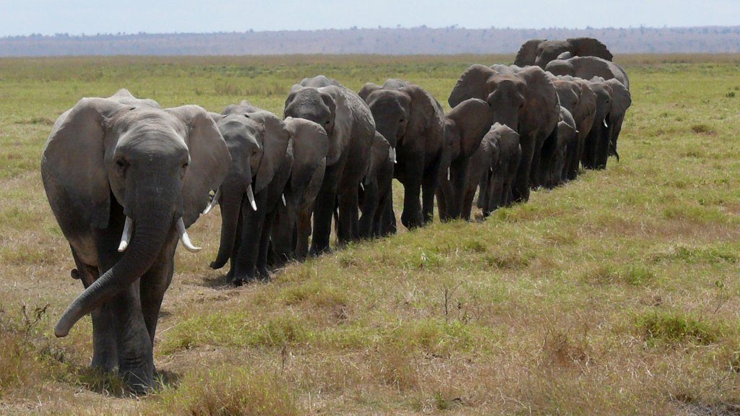
Unlimited growth does not occur for long in nature, studying nature in an ideal, unlimited environment reveals how fast a population can grow

Slide 3
Change in
Population = Births + immigrants entering
population - deaths -
emigrants leaving population

Slide 4
Per Capita Rate of Increase Formula
N represents population size
t represents time
Delta N is the change in population size
Delta t is the time interval
B is the number of births in the population during the time interval
D is the number of deaths

Slide 5
Delta N / Delta t
=B - D

Slide 6
Example: B=bN
B=0.034 x 500
B=17 per year

Slide 7
Calculating the expected number of deaths per unit time in a population of any size...

Slide 8
Formula
m=mortality
D=mN

Slide 9
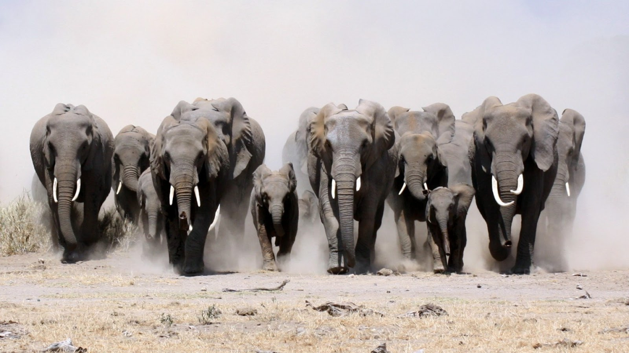
If m=0.016 per year, we would expect 16 deaths per year in a population of 1,000 individuals.

Slide 10
Formula
Now we can revise the population growth equation again, this time using per capita birth and death rates rather than the numbers of births and deaths

Slide 11
Delta N / Delta t = bN -mN

Slide 12
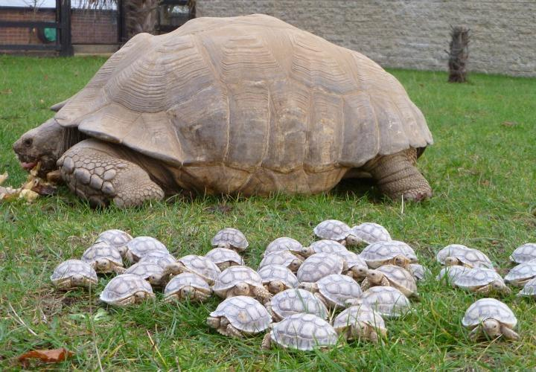
One final supplication is in order
Population ecologists are most interested in the difference between per capita birth rate and the per capita death rate. This difference is the per capita rate of increase.

Slide 13
r = b -m

Slide 14
The value of r indicates whether a given population is growing or declining. Zero population growth occurs when the per capita birth and death rates are equal (r = 0).

Slide 15
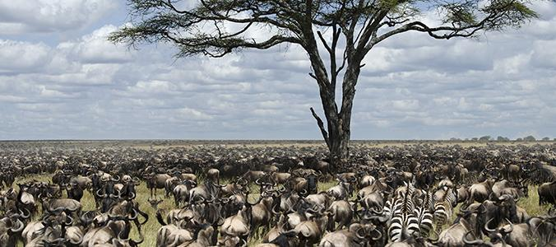
Births and deaths still occur in such a population, but they balance each other exactly.

Slide 16
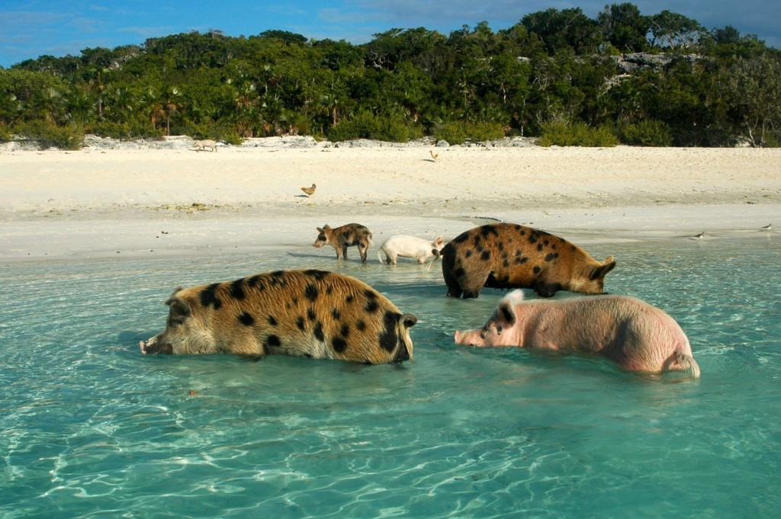
Using the per capita rate of increase, we can now rewrite the equation for population size as...

Slide 17
Delta N / Delta t = rN

Slide 18
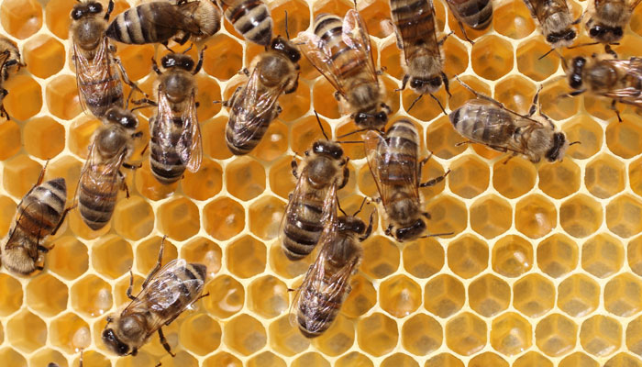
However, most ecologists prefer to use differential calculus to express population growth instantaneously, as growth rate particular instant of time

Slide 19
dN / dt = r inst N
r inst is the instantaneous per capita rate of increase

Slide 20
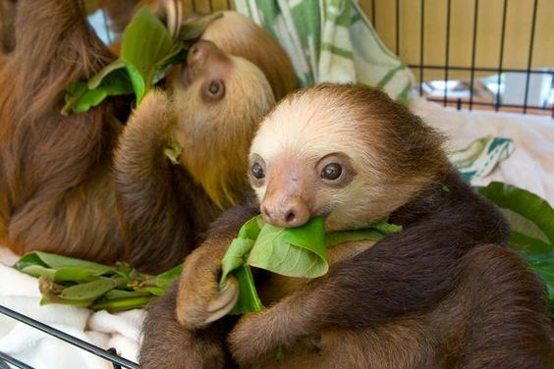
Exponential Growth
Under conditions of access to abundant food and are free to reproduce at their capacity, this is called exponential population growth, or geometric population growth.

Slide 21
The size of a population that is growing exponentially increases at a constant rate, resulting in a j-shaped growth curve

Slide 22
Under these conditions the per capita rate of increase may assume the maximum rate for the species,
r max

Slide 23
dN / dt = r maxN

Slide 24
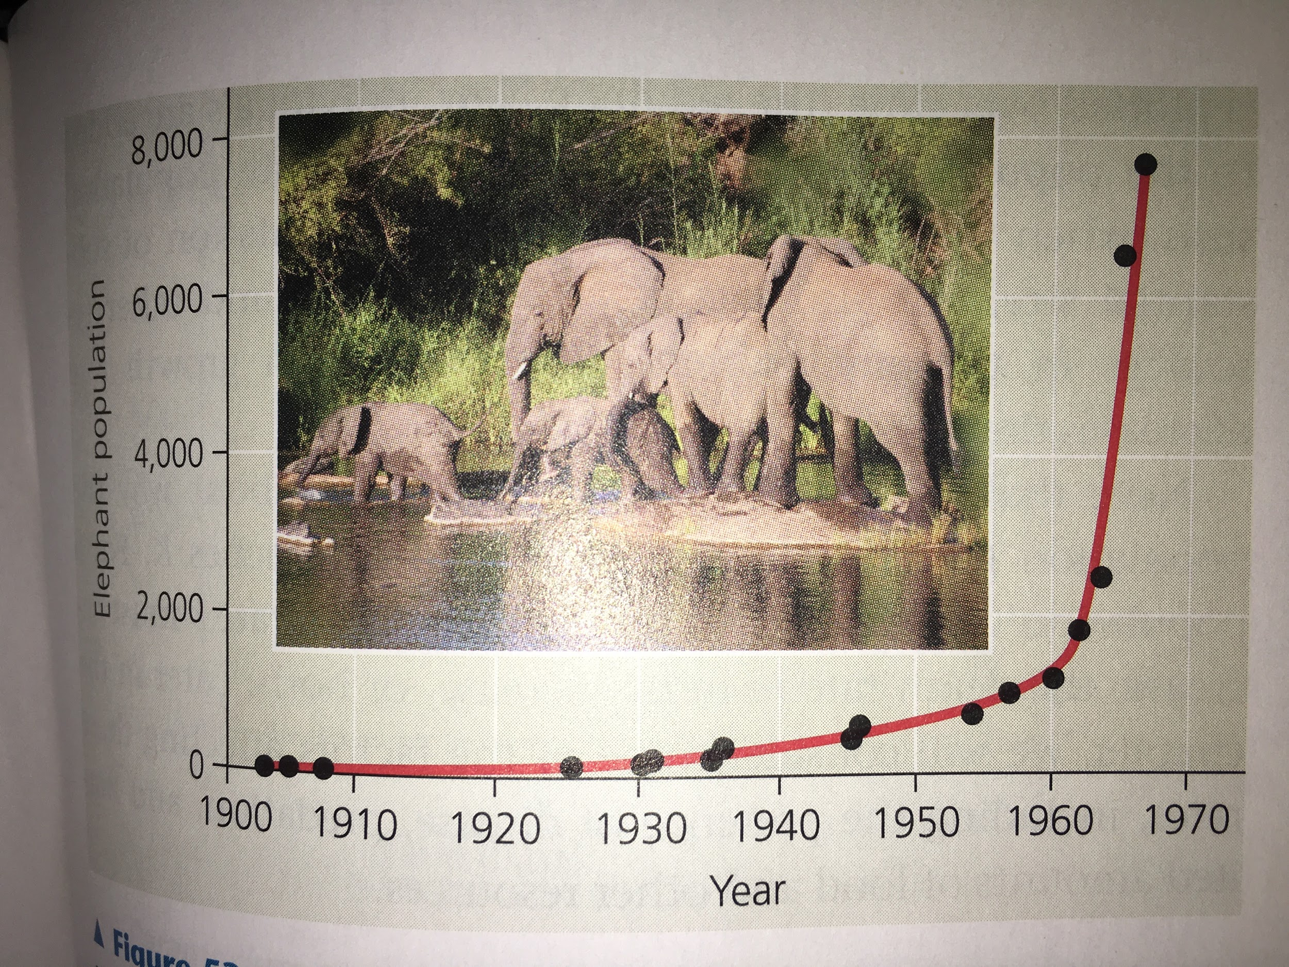
Example of an exponential function

