Slide 1
Chapter 53.3: The Logistic Model and Carrying Capacity
By Mike Fritz (sorry in advance)

Slide 2
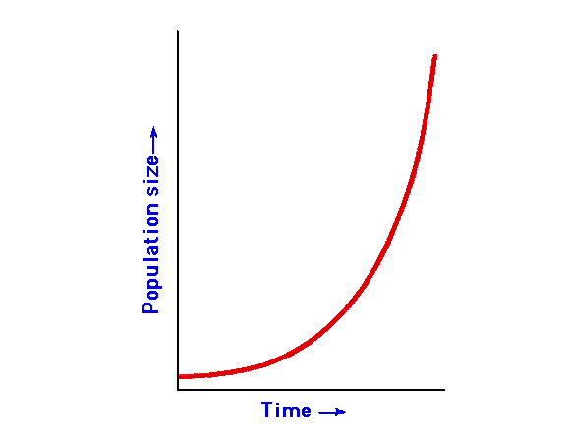
Exponential Growthidea
In any population, exponential growth can’t be maintained for a long period of time. Hence why the exponential growth formula shows the growth rate under ideal conditions. The formula is:
G = rN
– G is the growth rate of the population
– N is the population size
– r is the per capita rate of increase

Slide 3
Life History Traits and the Logistic Model
Life history traits that are favored by natural selection can vary in population density and environmental conditions.
K-selection , or density-dependent selection, selects for the life history traits that are sensitive to population density
R-selection , or density-independent selection, selects for the life history traits that maximize reproduction

Slide 4
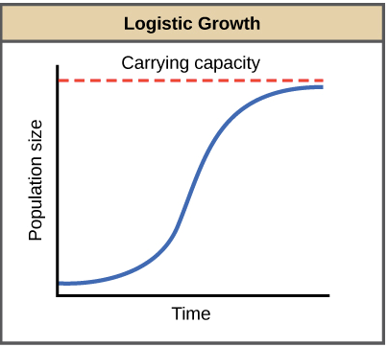

Slide 5
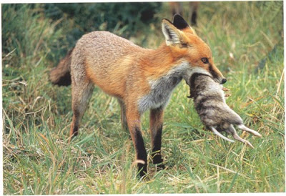
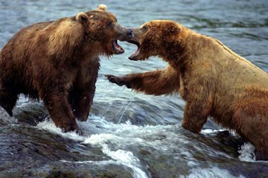
There are many methods of population control, such as:
Predation
Territorial Competition
Disease
Me too

Slide 6
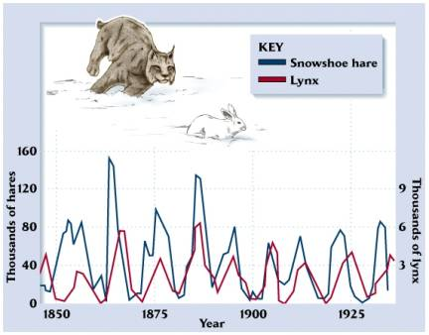
Populations fluctuate in density with regularity
Boom-and-bust cycles: rapid growth then falling back to a minimal level
–Food shortages
–Predator-prey interactions

Slide 7
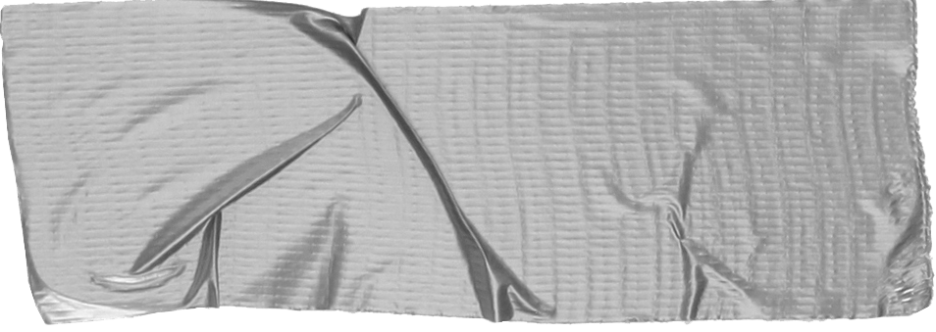
To Review:
Use the exponential growth formula, G=rN, to determine the growth of a population under ideal conditions.
Life history traits vary based on population density and environmental conditions.
Disease, territorial competition, and predation, etc. are natural methods of population control.
Populations fluctuate based boom-and-bust cycles like food shortages and predator-prey interactions.

Slide 8
What people are saying
PLEASE SEND HELP
Me at 10:55 doing this presentation
Cash me ousside then, howbow dah
Me at 12:03 still doing this presentation
DEAR GOD WHY AM I LIKE THIS
Me at 3:46 about to finish this presentation

Slide 9
Good luck!
I hope you understand growth models and carrying capacity a little bit better after this garbage presentation. Lord knows there’s like, millions of other people who could’ve explained this a whole lot better than I did. In the word of the queen herself:
“I wish you success”
-Mrs. Pegg
Source: http://learning.hccs.edu/faculty/victor.wong/biology-1407-powerpoints/chapter-53-population-ecology/view

