Slide 1
The Logistic Growth Model
53.3
53.3

Slide 2
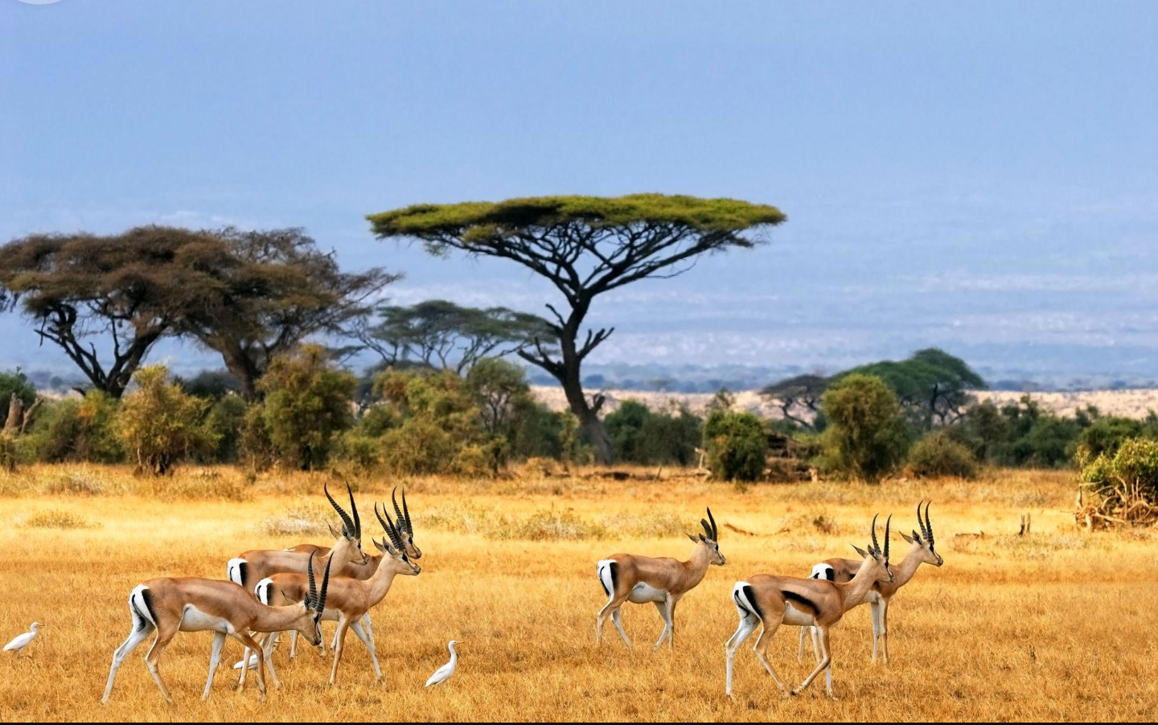
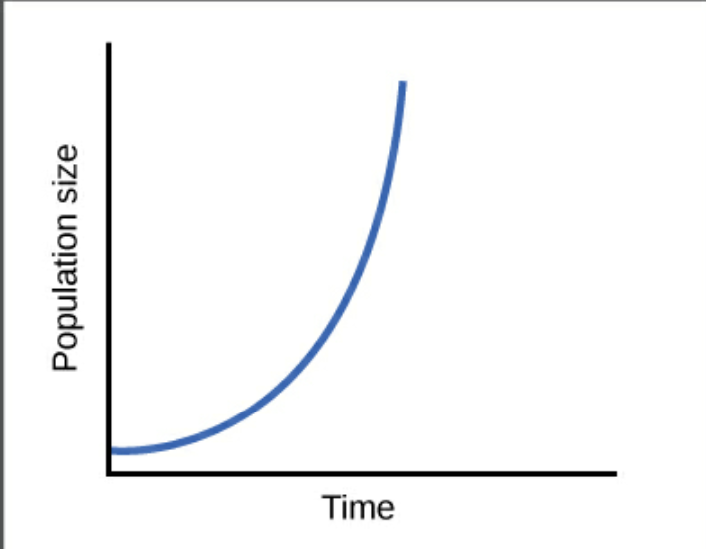
Background: Exponential Growth Model
In the Exponential Growth Model, it is assumed that resources are unlimited.
Resulting in a constant growth of population.
Carrying capacity

Slide 3
Carrying capacity
The maximum population size that a particular environment can sustain
A Few Limiting Factors
-Energy
- Shelter
- Nutrient Availability
- Water

Slide 4
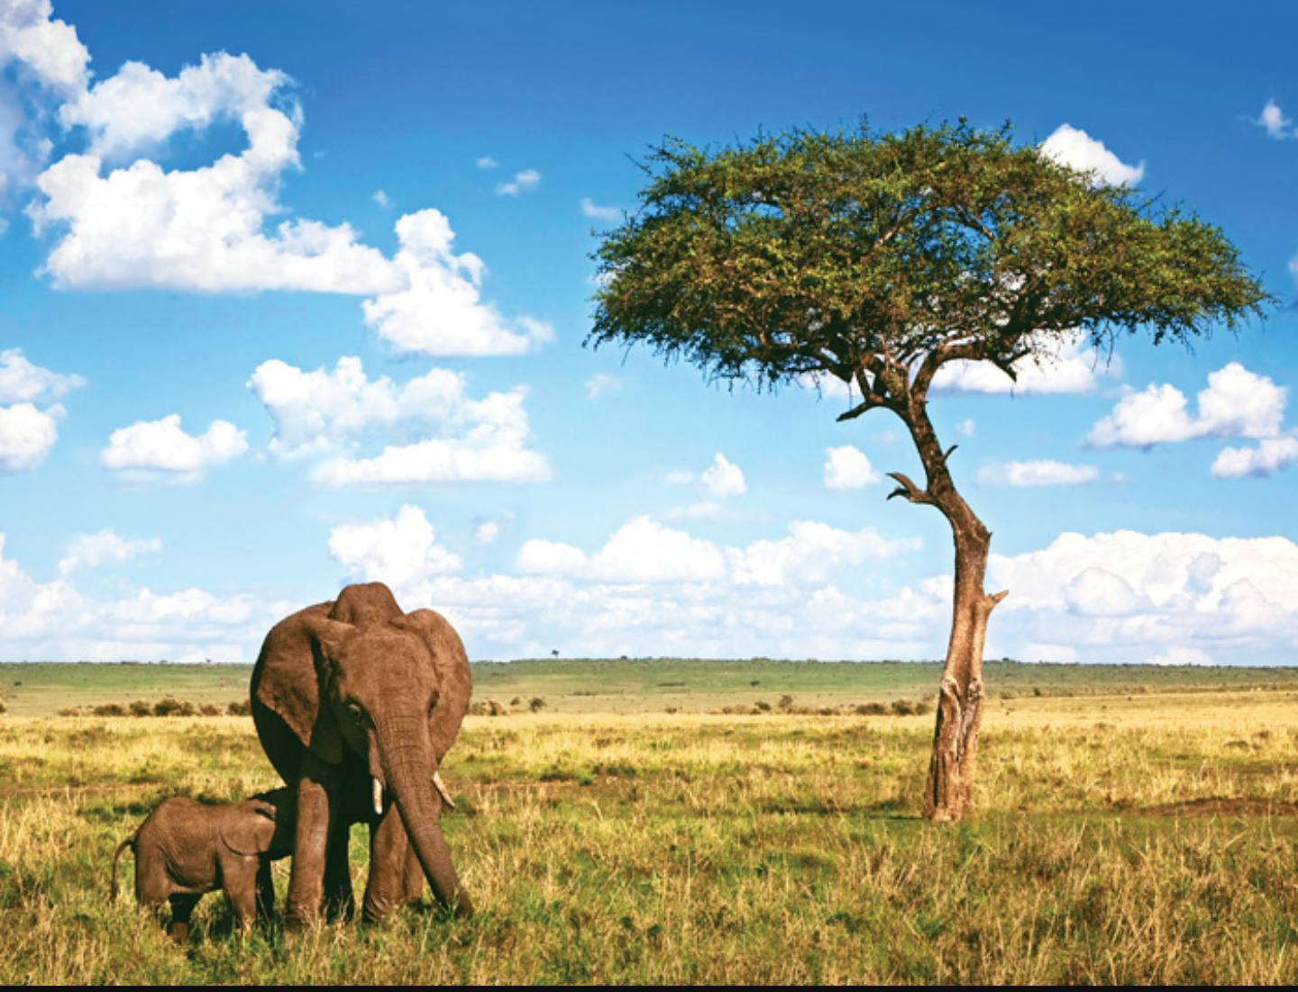
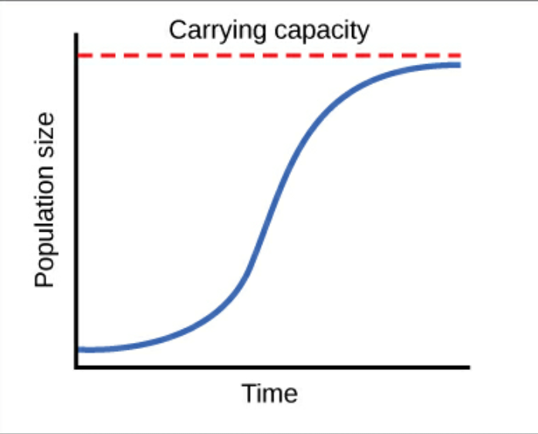
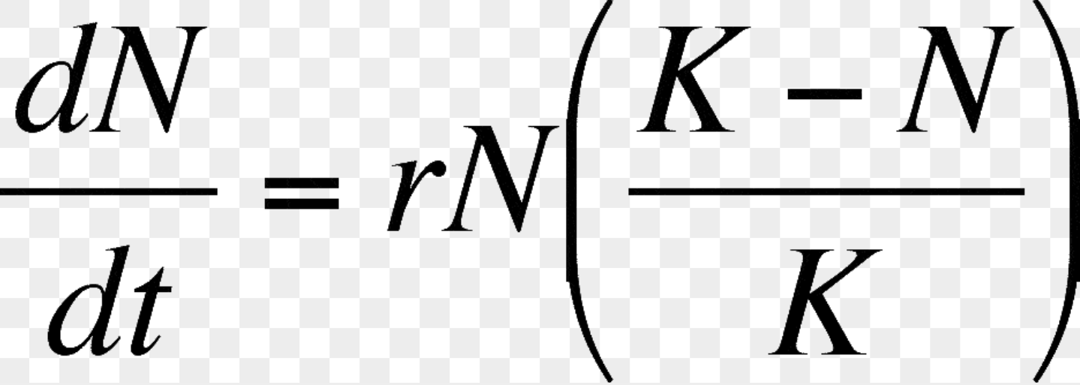
The Logistic Growth Model

Slide 5
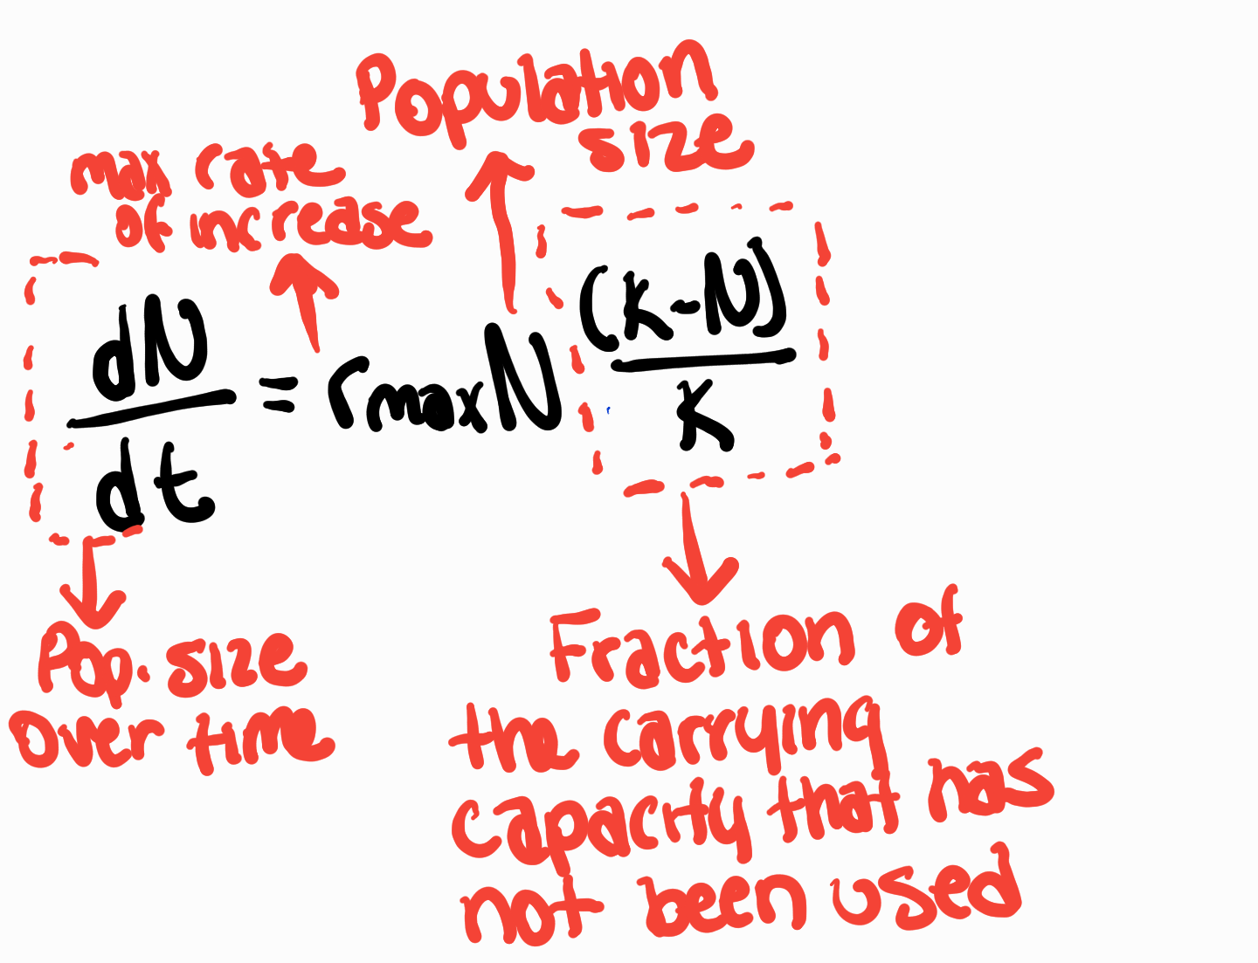
Logistic Growth Model Formula

Slide 7
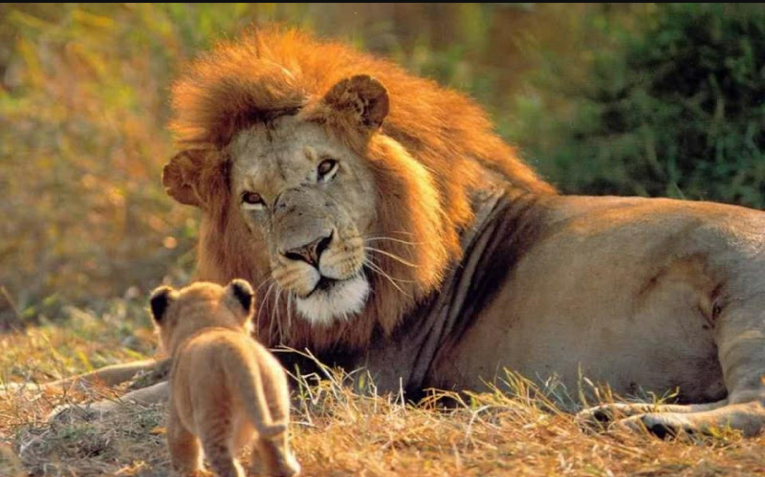
Factors that affect the Logistic Model
K= maximum sustainable population size
N= population size
b = per capita birth rate
m = per captia death rate
r = per captia rate of increase
A decrease in b or an increase in m causes r to change
The Best Size of Population : Intermediate
Not too many, not too little
Enough space/ resources

Slide 8
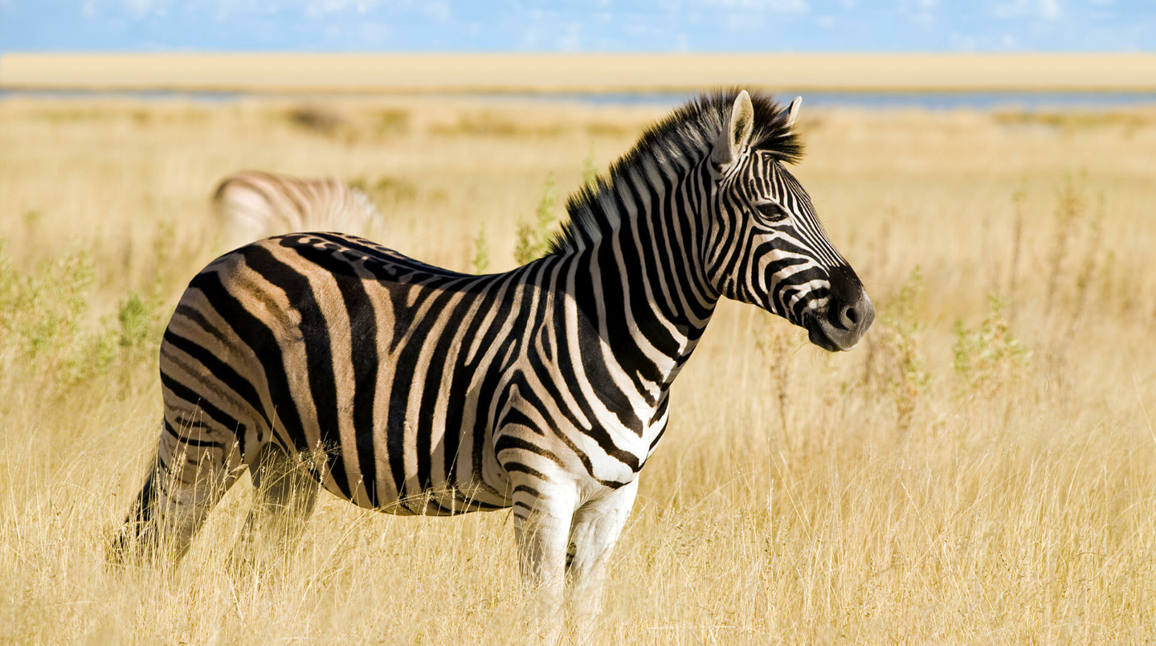
Logistic Model V.S. Real Life
Not all assumptions made by the model fit into real populations
False: Most populations have a decrease of some sort before they can adjust to a new situation.
Assumption #1: “ All populations adjust instantaneously to growth and approach carrying capacity smoothly.”

Slide 9
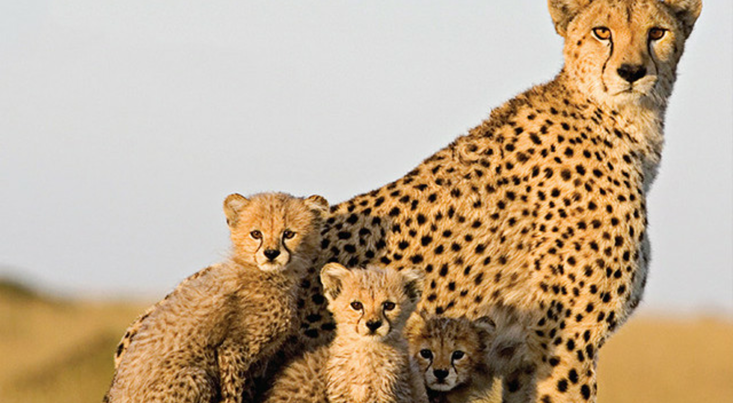
Logistic Model V.S. Real Life
Assumption #2: “ Regardless of population density, each individual added to a population has the same effect on population growth rate.”
Allee Effect by W.C. Allee
Idea that individuals have a harder time surviving in small populations.

Slide 10
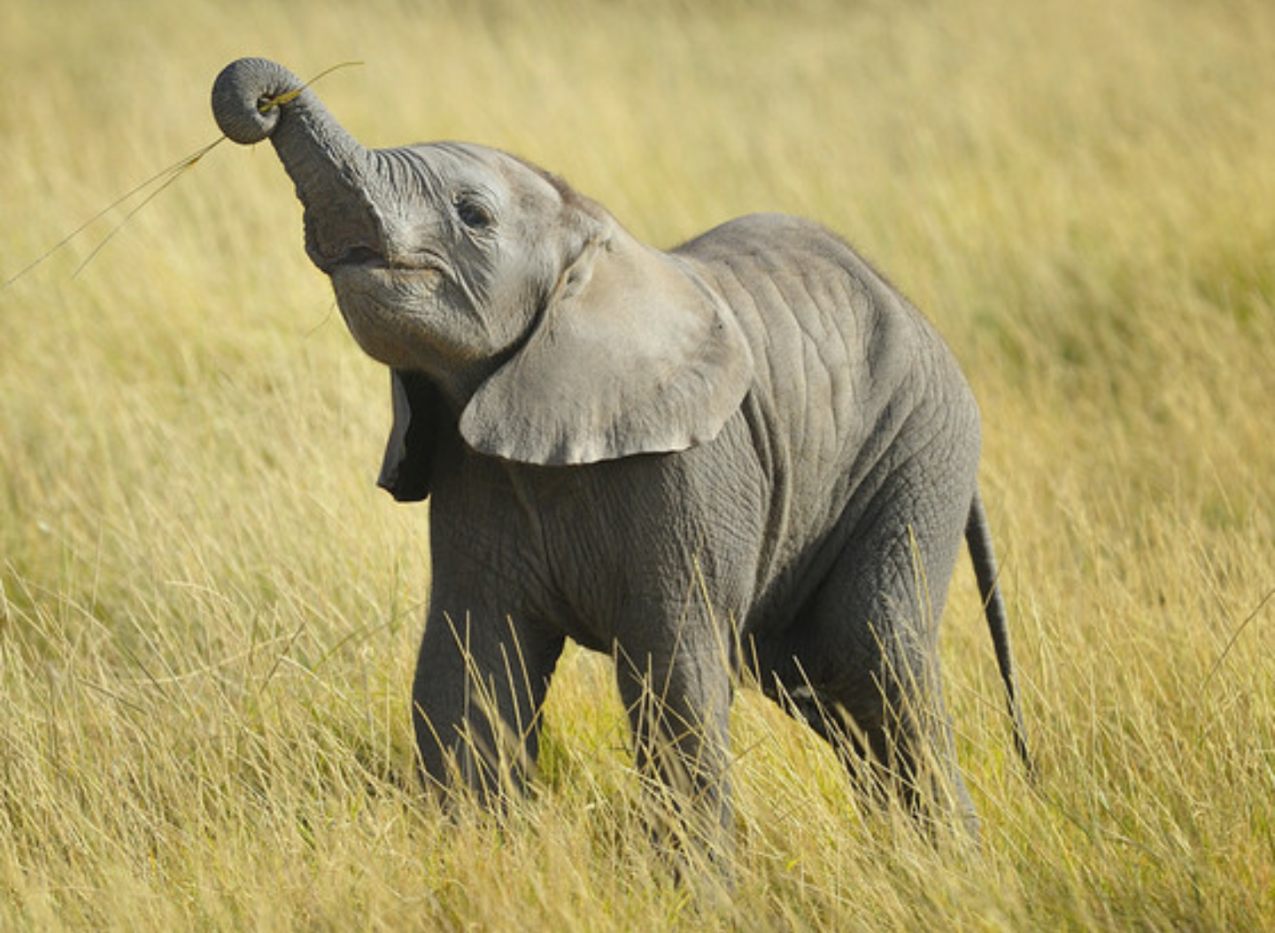
The Logistic Model in use
Helps with Conservation Biology
Helps “ estimate sustainable harvest rates for wildlife population”
Source: Biology Textbook

