Slide 1
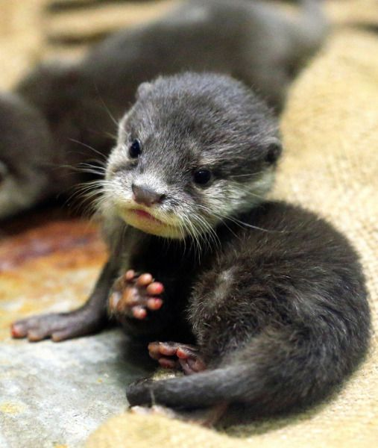
Life History Traits are Products of Natural Selection
53.4
Jess Goetz

Slide 2
What exactly is a life history in this context?
All species must trade-off between survival and reproductive traits during the process of evolution.
The life history of an organism are the traits that affect its schedule of reproduction and survival.
Entails 3 main variables:
When reproduction begins
How often the organism reproduces
How many offspring are produced per reproductive cycle
These traits occur involuntarily

Slide 3
Semelparity vs. Iteroparity
Reproduction in which an organism produces all of its offspring in a single event.
Big-bang reproduction
Example: agave plants
Agaves grow for years in arid climates until there is an unusually wet year, when it will send up a large flowering stalk that produces seeds, and then dies.
Reproduction in which adults produce offspring over many years.
Repeated reproduction
Example: lizards
Some lizards produce a few large, nutrient-containing eggs annually beginning in their second year of life.

Slide 4
What makes an organism favor semelparity and iteroparity?
An organism living in an unpredictable environment will likely favor semelparity. The adult would be less likely to survive, so producing a large number of offspring will increase the possibility of at least a few survivors.
Iteroparity may be favored in an environment where adults are more likely to survive and breed again, and where there is an increased competition for resources.

Slide 5
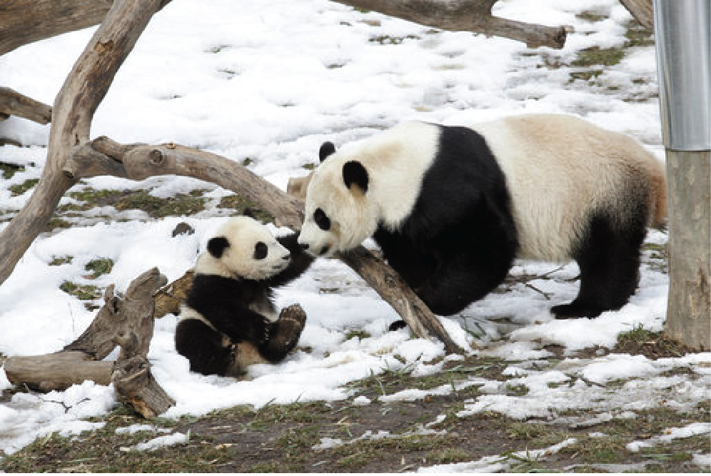

Slide 6
K-selection and r-selection
Selection for traits that are sensitive to population density and are favored at high densities is known as K-selection (density-dependent selection).
Example: mature trees growing in an old-growth forest
Selection for traits that maximize reproductive success in low density environments is called r-selection (density-independent selection).
Example: weeds growing in an abandoned agricultural field
K represents the carrying capacity of an environment
r represents the per capita rate of increase

Slide 7
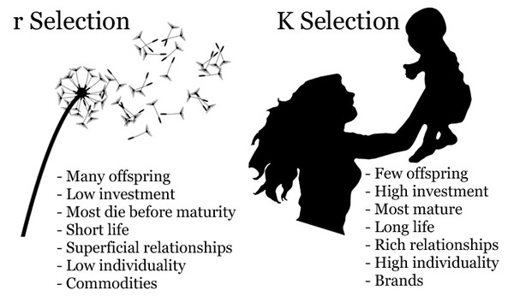
In other words...

Slide 8
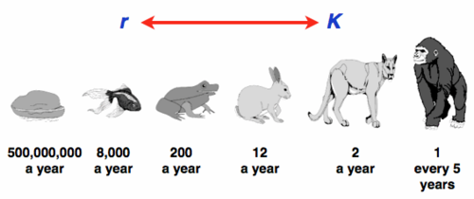
In summation,
Organisms evolve through the process of natural selection in ways that either improve traits relating to reproduction or survival.
Semelparity and iteroparity refer to the amount of offspring produced and the parental involvement.
K-selection denotes the selection for life history traits that are sensitive to population density.
r-selection is the selection of life history traits that capitalize on reproductive success where there is low competition.

