Slide 1
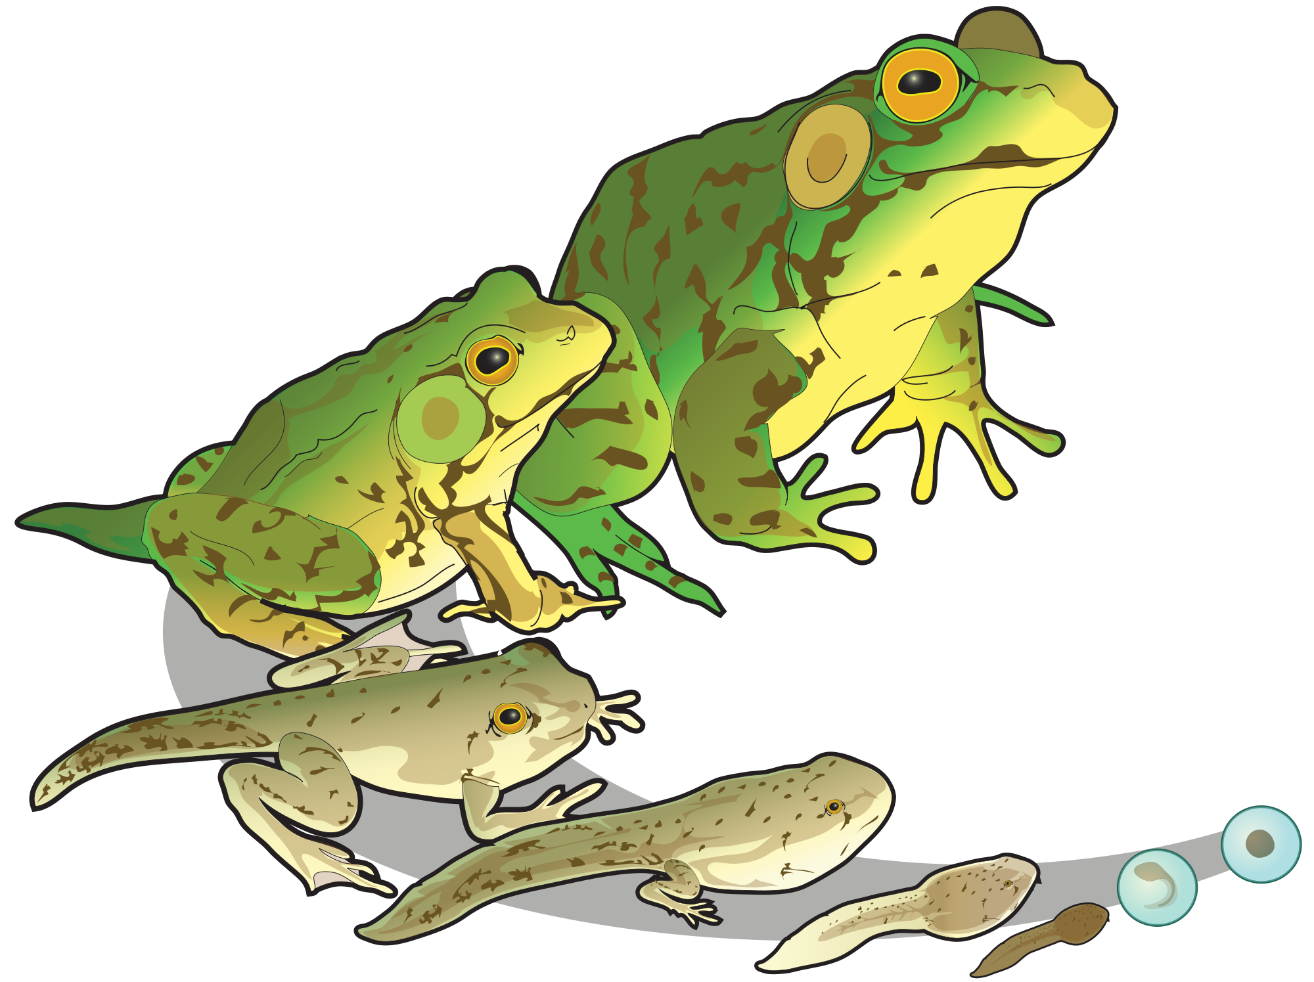
Population Ecology: 53.4
By Chelsea

Slide 2
Life History
Life history - the traits that affect an organism’s schedule of reproduction and survival.
Life history has three variables:
When reproduction begins
How often the organism reproduces
How often the organism reproduces, and the amount of offspring it produces.
Note: Organisms do not choose consciously when to reproduce or how many offspring to have

Slide 3
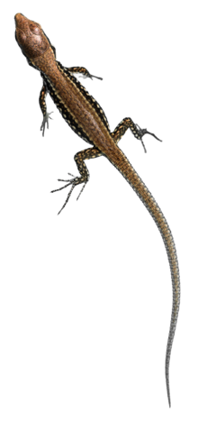
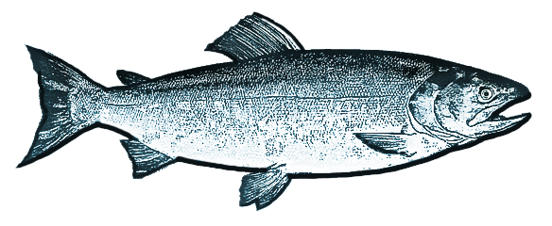
Evolution and Life History Diversity
Semelparity and Iteroparity are two reproduction strategies:
Semelparity | Iteroparity
A “one-shot” pattern of big-bang reproduction. Semel means “once” in Latin. An example of semelparity is a salmon, which migrates and produces thousands of eggs in a single reproductive opportunity before it dies. | Defined as repeated reproduction. An organism produces a few large offspring every time they reproduce. An example of iteroparity is a lizard. They produce only a few large eggs in the second year of their life.

Slide 4
What factors contribute to the evolution of semelparity vs. iteroparity?
Two Factors:
The survival rate of the offspring
The likelihood that the adult will survive to reproduce again

Slide 5
Low survival rates of offspring typically favor semelparity.
Adults are less likely to survive in unpredictable/highly variable environments. Large production of offspring will ensure that at least some will survive during that time.
Iteroparity is favored in dependable environments
Adults have survived to breed once more, and competition for resources can be intense.
Few large, well off offspring would have a better chance of surviving until they can reproduce

Slide 6
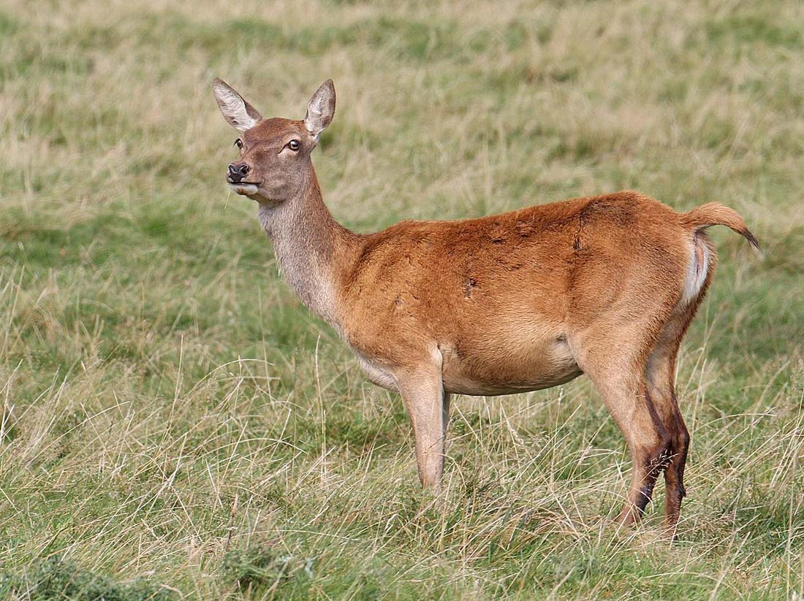
“Trade-offs” and Life Histories
No organism can produce as many offspring as a semelparous species and provision them as well as an iteroparous species. There is a trade-off (one thing increases and another decreases, as a result) between reproduction and survival.
For example, researchers found that a female red deer that reproduced in a given summer was more likely to die the next winter than females that did not reproduce

Slide 7
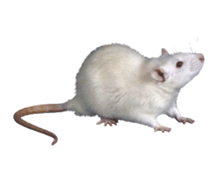
Selective pressures influence the trade-off between the number and size of offspring.
Organisms that are have high mortality rates will produce large numbers of relatively small offspring.
For example, mice because of a high rate of predation.
Parents also influence the survival of offspring.
For example, Brazil nut trees provision large seeds with nutrients that help the seedlings become established.

Slide 8
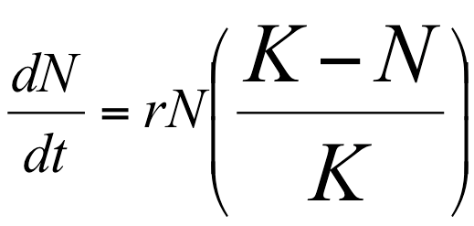
Connection of favored traits at different population densities
K-selection - selection for traits that are sensitive to population density and are favored at high densities. (Density-dependent selection)
R-selection - selection for traits that maximize reproductive success in uncrowded environments. (density-independent selection)
The names follow the variables of the logistic equation.

Slide 9
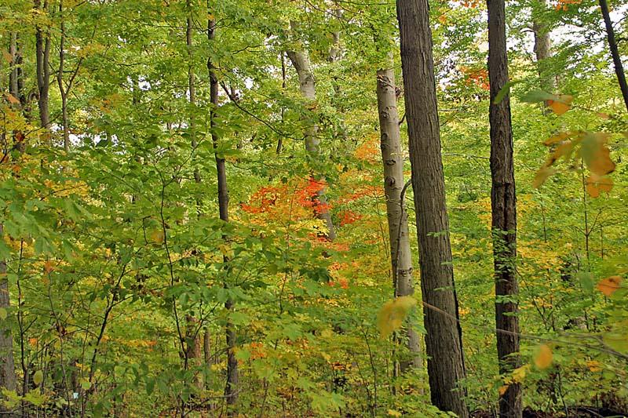
K- selection
Operates in populations living at a density near the highest capacity. It’s imposed by their resources (the carrying capacity, K).
Competition among the individuals is strong.
For example, Mature trees growing in an oldgrowth forest.

Slide 10
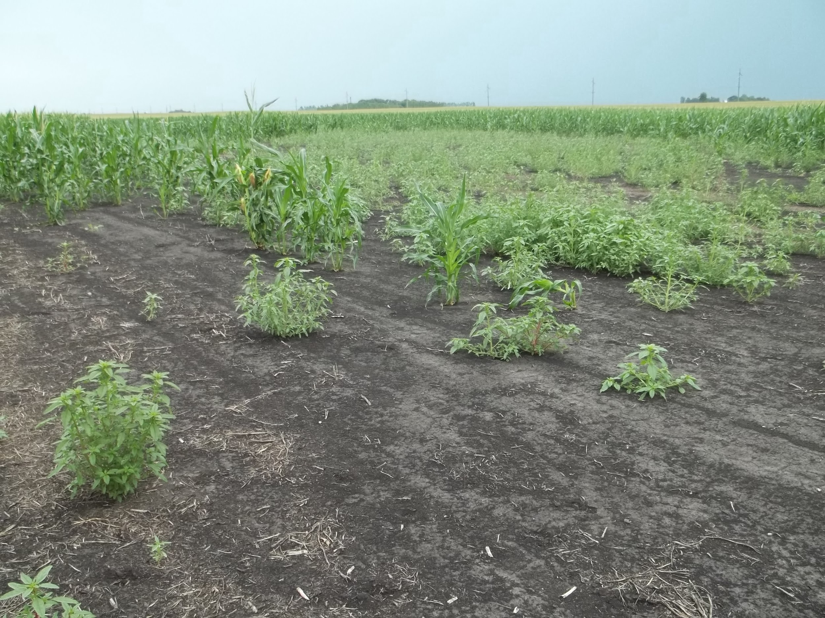
r-selection
Occurs in environments in which population densities are well below its carrying capacity
Individuals face little competition among each other
Conditions are often found in disturbed habitats.
For example, random weeds growing in a field.

Slide 11
What have k- and r-selections done?
K- and r-selection represent two extremes in a range of actual life histories.
They have helped ecologists propose alternative hypotheses of life history evolution.
Provided more thorough study of how factors such as disturbance, stress, and the frequency of opportunities for successful reproduction affect the evolution of life histories.

Slide 12
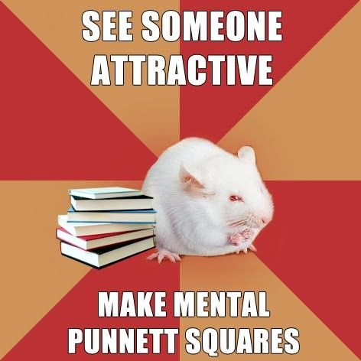
THIS PHOTO HAS NOTHING TO DO WITH THIS SLIDESHOW, BUT IT WAS FUNNY....

