Slide 1
AP Bio:
Ch. 53.5
By: Daniel Johnston

Slide 2
Chapter 53.5 Population Application
There are many environmental factors that keep populations from growing, and many that promote their growth
Population application is relevant to many everyday situations
Like farmers who want to stop the growth of a weed
Better understanding this topic can help us better grasp our environment and gain the most we can out of it
It can also help us create scenarios to help endangered species from going extinct

Slide 3
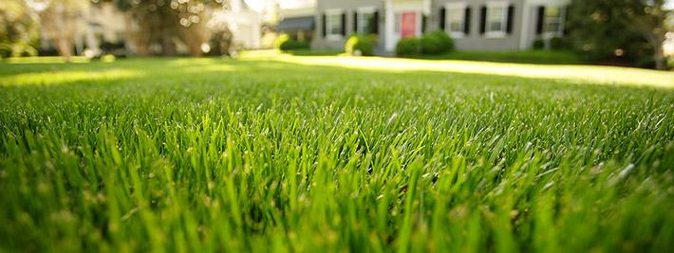
Ecologists study birth rates, death rates, immigration and emigration and their relationship with population density to better understand population growth
A populations that is density independent is one that's birth/death rate isn't affected by population density
A population that is density dependent is one that's death rate rises when population rate increases (birth rate decreases).
Ex: dune fescue grass reproduces less as population density increases because there's less space for it to grow

Slide 4
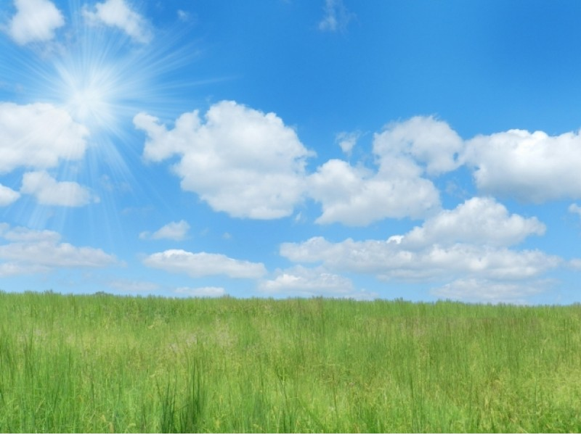
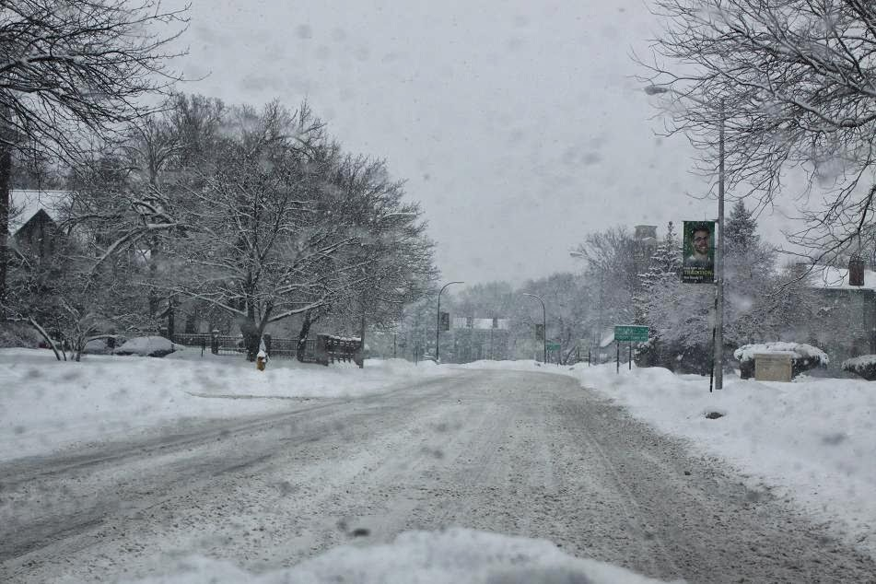
Population regulation occurs from negative feedback between population density and birth rates
Without this communication, a population would never stop growing and just keep reproducing
There are many mechanisms in nature that come into effect to alter birth rates
Ex: drought, harsh weather, nice weather, parasite growth, food populations

Slide 5
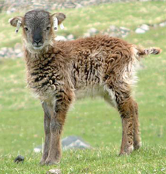
Population fluctuations that differ from year to year and place to place are called population dynamics
Environmental conditions play a big role in this
Ex: when the soay sheep population was high, weather was harsh and food was less abundant; when the population was less dense the weather was more mild and more food was accessible
Some populations variations are random, while others are specific and cyclic

Slide 6
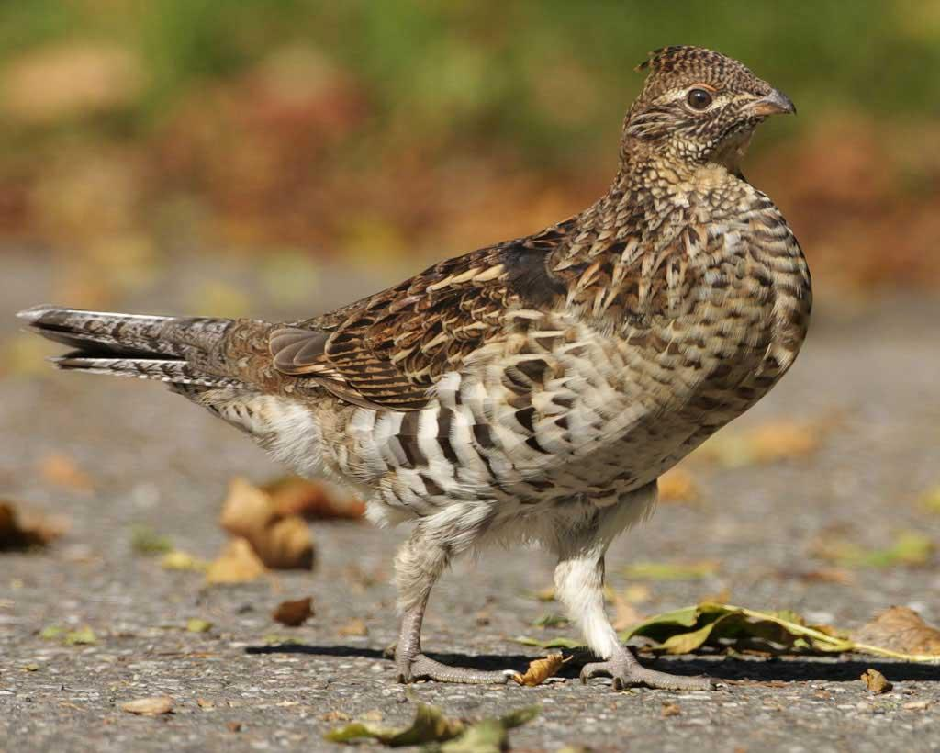
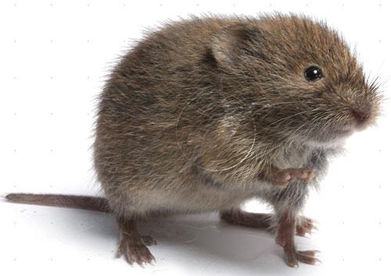
Small herbavoric mammals, like the vole, have a three to four year population dynamics cycle
Some birds, like the ruffled grouse, have a nine to eleven year cycle

Slide 7
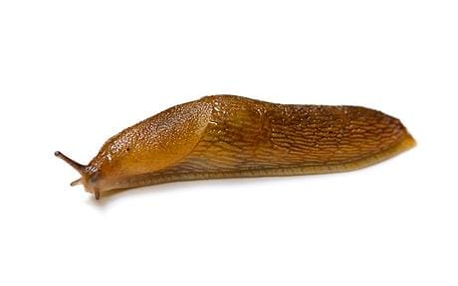
Sometimes when environmental conditions are rough and unsuitable for a population, they'll emigrate and immigrate to a population more suitable
Sometime populations will come together and work together, this is called a metapopulation
Ex: a slug is thousands of slime mold amoebas formed to one mass. They form when food is scarce and work together to travel greater distance and find more

Slide 8
Conclusion
Population regulation has many features and factors
Birth and death rates are affected by population density as well as environmental factors
These changes can be random and also cyclic
Who knew slugs were made of amoebas (not this guy)
The end :)

