Slide 1
54.2 Diversity and trophic structure characterize biological communities
By Jennifer Lopez

Slide 2
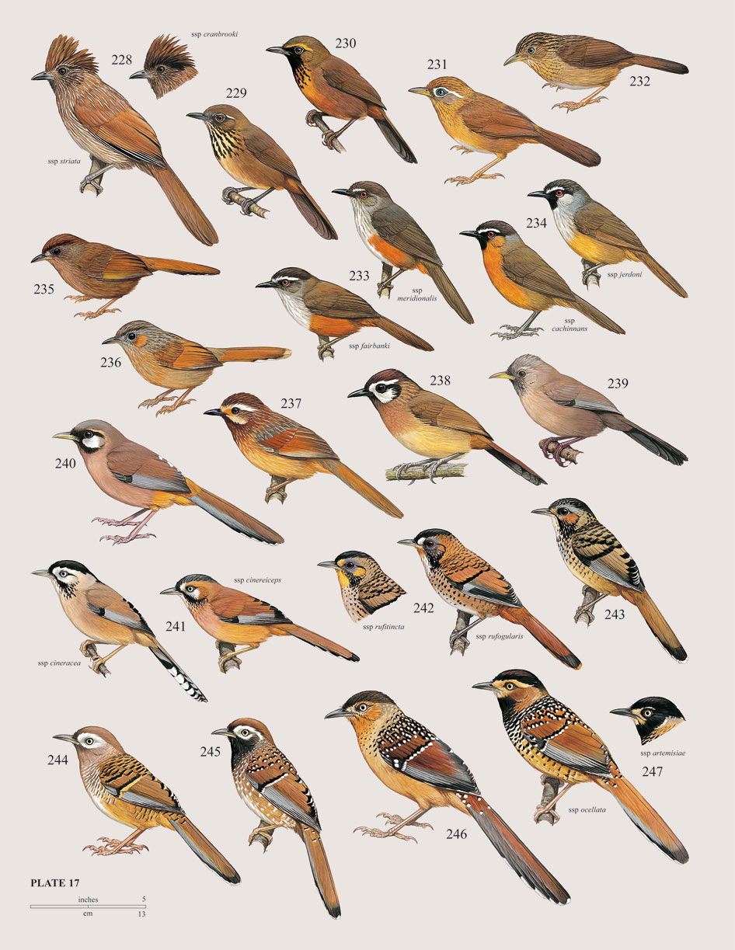
In order for a community to be successful, there must be diversity between species. The greater the diversity in a community, the greater the productivity, and success during stressful times such as a drought, or the introduction of an invasive species.

Slide 3
Species diversity depends on both:
-Species richness- The number of different species in an ecosystem
-Relative Abundance- The proportion of different species to one another in an ecosystem.

Slide 4
Species diversity can be calculated by using the Shannon Diversity Index
H = Diversity of a community
A,B,C…= different species
P= Relative abundance (proportion to other species)
The greater the value of H, the greater the diversity.
However, these calculations are difficult to conduct in nature because you need ALL species and individuals.
H= -(PAlnPA + PBlnPB + PClnPC…)

Slide 5
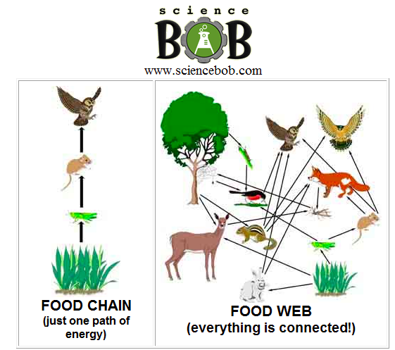
Trophic Structures
Another important part to community dynamics are the feeding structures, also known as the trophic structure.
Trophic structures have links, or levels, to describe each organism's role in the chain. There are primary producers, primary consumers, secondary consumers etc. Also known as producers, herbivores, carnivores, and decomposers.
Trophic structures can be represented by food webs and food chains.
Food webs give a broader look at feeding relations, while food chains give an isolated and specific look at particular species.

Slide 6
Food chains are relatively short, rarely ever greater than seven links from producer, to the top predator. There are two hypotheses behind this.
Energetic Hypothesis - Inefficiency of energy transfer from one level to the next. Only about 10% of energy is passed on to the next level therefore a producer consisting of 100 kg can support 10 kg of herbivore biomass, and 1 kg or carnivore biomass.
Dynamic Stability Hypothesis- The longer a food chain, the less stable it will be. If for some reason a lower population decreases, predators on a shorter chain will be able to recover more quickly.

Slide 7
Certain species will have a very strong impact on a community.
Dominant Species - The most abundant, or have the greatest biomass in a community. Although it is not clear why certain species become dominant, there are hypotheses stating it could be they are best at avoiding predators, or best at exploiting resources.

Slide 8
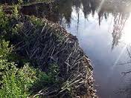
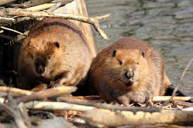
Keystone Species And Ecosystem Engineers
Keystone Species are not the most abundant, but have strong control over a community because of their role, or niche.
Ex. Sea otters feed on sea urchins, who feed on kelp. When sea otters are present, urchin populations are low and kelp forests are well developed. When sea otters aren’t present, urchin populations are high, and kelp is nearly absent
Ecosystem engineers are species that dramatically change their environment.
Ex. Beavers have strong control for their ability to alter a stream.

Slide 9
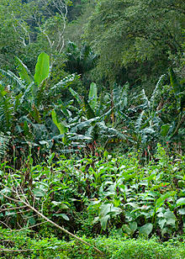
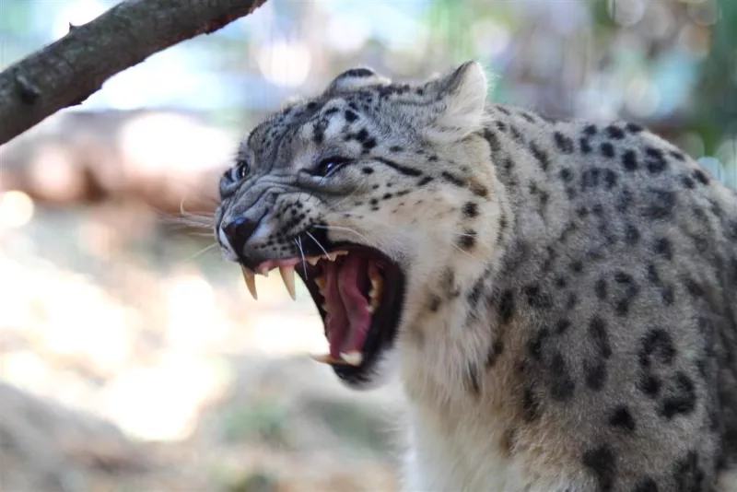
Describing Trophic Structures
The Top Down Model demonstrates the opposite. The model shows how a top predator can control all the populations below it with a trophic cascade effect. If a top predator disappears, its prey will increase in population, which will cause their prey to decrease, and so on.
Relationships can also be described by how they are controlled. One description is the Bottom Up Model. This model works from the bottom of the food chain upwards in that the producer controls the populations it can support.

Slide 10
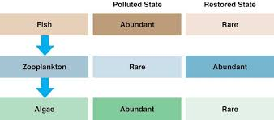
Biomanipulation
Using the top down theory, scientists are able to to control populations of species through introducing new predators into an environment. It is often used in water environments to improve water quality.

