Slide 1
Chapter 54 Section 4
Biogeographic factors affect community diversity
by Olivia Racette

Slide 2
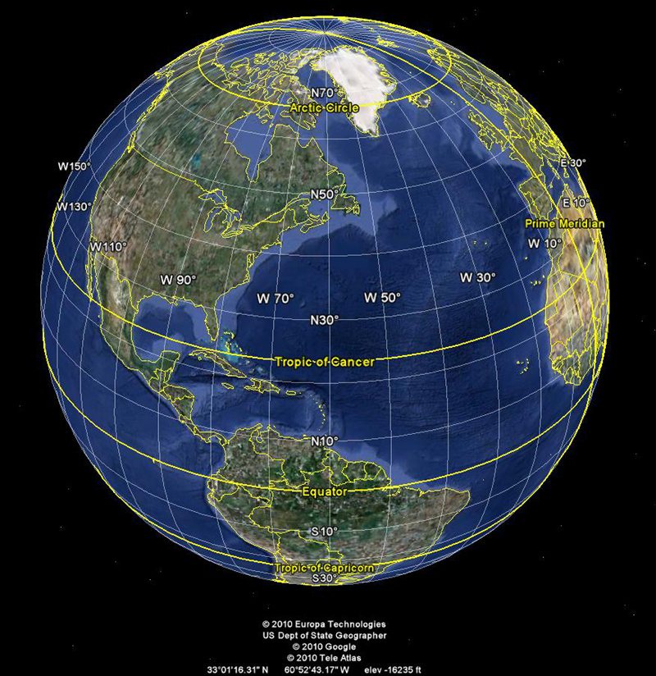
LATITUDINAL GRADIENTS

Slide 3
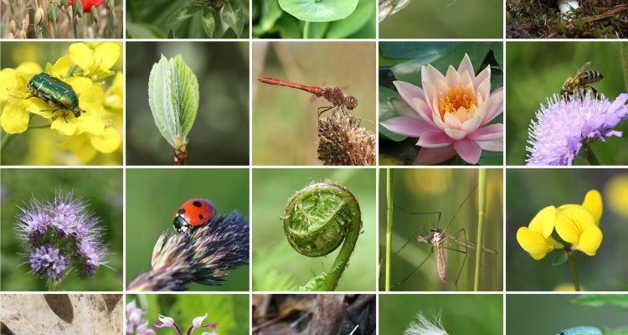
Diversity in Tropics
Depending on the different latitude, there’s more diversity at the tropics than towards the poles.
2 Reasons for this:
Evolutionary History
Climate

Slide 4
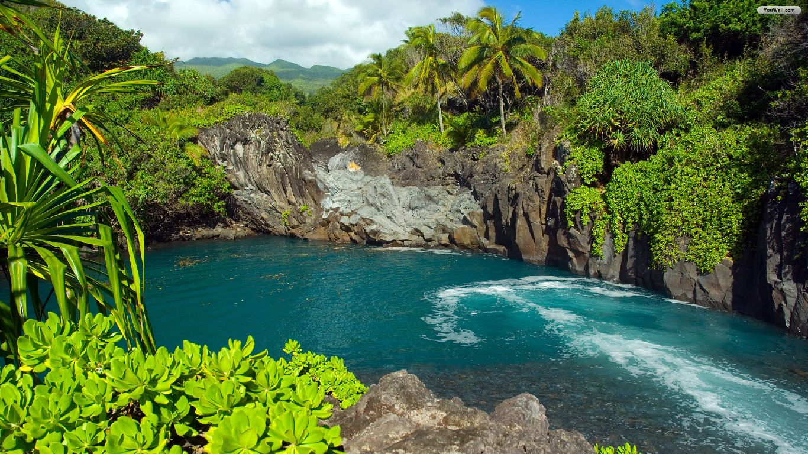
Evolutionary History
Glaciations caused life to start over, and affected the temperate and polar areas, not the tropics.
Therefore, tropic communities are older, and have increased their variety of species at a larger rate than temperate and polar areas.
Tropics have growing seasons that are five times longer than those in the tundra.
Tundra communities are at higher latitudes.
There are also shorter intervals between speciation events due to ‘biological time’ running about 5x faster in the tropics than near the poles.
Species richness may increase in a community as more speciation events occur.

Slide 5
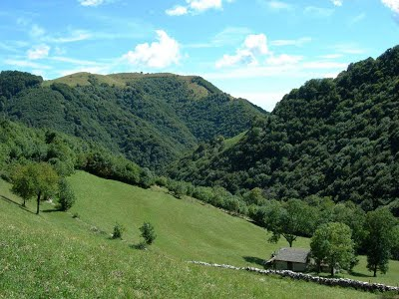
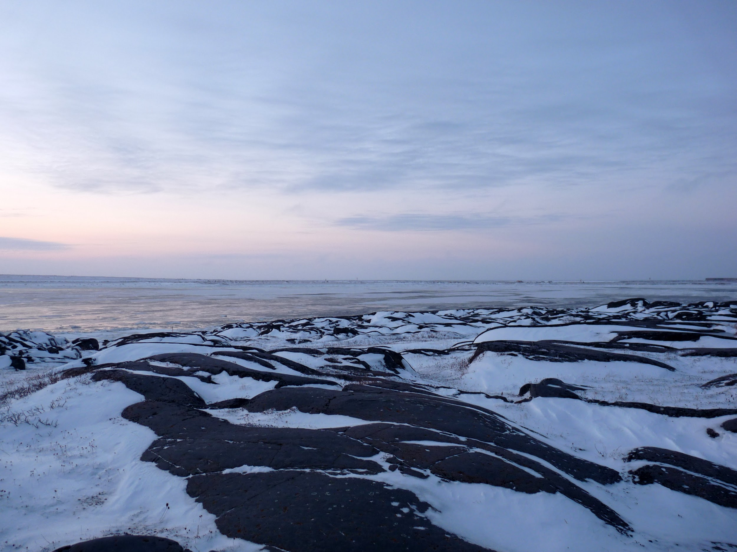
Climate
The input of solar energy and water availability both contribute to increased evapotranspiration.
Evapotranspiration is the evaporation of water from soil plus the transpiration of water from plants.
In other terms, a hot, rainy environment is more productive than a cold, dry environment.
Potential evapotranspiration is determined by the amount of solar radiation and temperature.
The primary cause of the latitudinal gradient in richness and diversity.

Slide 6
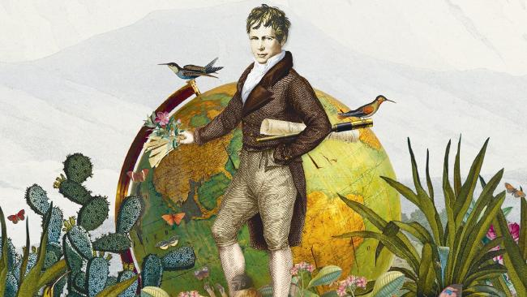
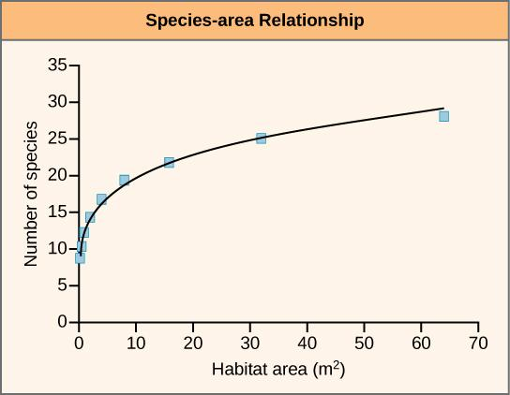
AREA EFFECTS
Created by naturalist Alexander von Humboldt, the species-area curve stated: all other factors being equal, the larger the geographic area of a community, the more species it has.
Larger areas offer a greater diversity of habitats and microhabitats than smaller areas.
Developing species-area curves helps ecologists predict the potential loss of a certain area of a habitat is likely to affect the community’s diversity.

Slide 7
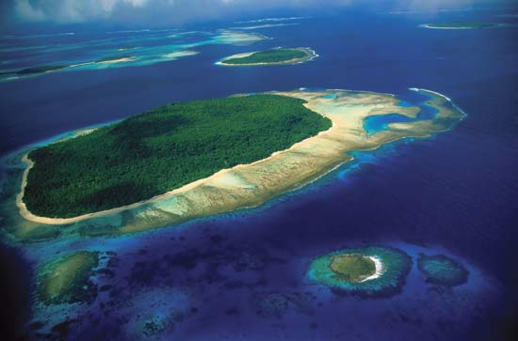
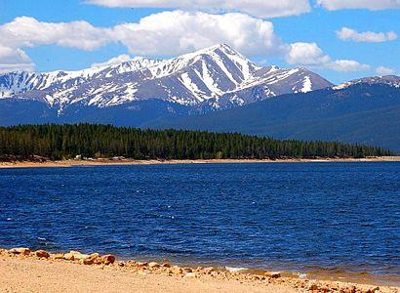
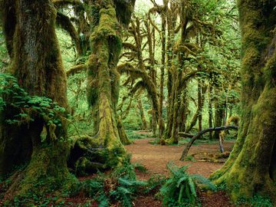
Island Equilibrium Model
Besides oceanic islands, there are also habitat islands: lakes, mountain peaks, or natural woodlands.
When considering a newly formed island, two factors that determine the number of species include:
The rate at which new species immigrate to the island
The rate at which species become extinct on the island
As the number of species on the island increases, the immigration rate of new species decreases.
Any individual that reaches the island is less likely to represent a species that is already present

Slide 8
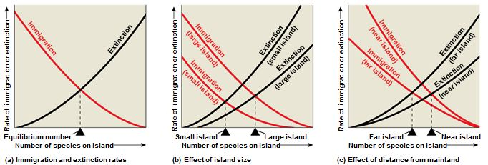
Island Equilibrium Model
MacArthur and Wilson’s model is called the island equilibrium model because an equilibrium will eventually be reached where rate of species immigration = rate of species extinction.
Two features that affect immigration and extinction rates include: size and isolation.
Small islands have lower immigration rates because potential colonizers are less likely to reach it.
E.g. Birds blown out to sea by a storm are more likely to land by chance on a large island than on a small one.
MacArthur and Wilson’s studies support the prediction that species richness increases with island size, and that the number of species decreases with increasing remoteness of the island.
Predictions of species composition based on the model:
Short Term: Colonization
Long Term: Abiotic Disturbances, Adaptive Evolutionary Changes, Speciation

