Slide 1
Chapter 55.1
Physical laws govern energy flow and chemical cycling in ecosystems

Slide 2
Concept of Chapter 55, Section 1
An ecosystem consists of all organisms in a community and all the abiotic factors with which they interact. Laws of physics and chemistry apply to ecosystems, particularly in but degraded to heat during ecosystem processes.
Based on the law of conservation of mass, ecologists study how much of a chemical element enter and leaves an ecosystem and cycles within it. Inputs and outputs are generally small compared to recycled amounts, but their balance determines whether the ecosystem gains or loses an element over time.

Slide 3
Vocabulary
Ecosystem, consists of all organisms in a community and all the abiotic factors with which they interact.
Law of conservation of mass is as important for ecosystem as the laws of thermodynamics are, mass is conserved. Matter cannot be created or destroyed.
Primary producers, the trophic level that ultimately supports all other consists of autotrophs
Primary consumers, herbivores, which only eat plants and other primary producers (example: chemosynthetic prokaryotes)
Secondary consumers, carnivores that eat herbivores
Tertiary consumers, carnivores that eat other carnivores
Detritivores or Decomposers, group of heterotrophs (refer to consumer that get their energy from detritus)
Detritus, is a nonliving organic material, such as the remains of dead organisms, feces, fallen leaves, and wood. Eaten by secondary and tertiary consumets. 2 groups: prokaryotes and fungi

Slide 4
Conservation of Energy
The first law of thermodynamics, states that energy cannot be created or destroyed but only transferred or transformed. We can potentially account for the transfer of energy through an ecosystem from its input as solar radiation to its release as heat from organisms.
Plants and other photosynthetic organisms convert solar energy to chemical energy, but the total amount of energy does not change: amount of energy stored in organic molecules must equal the total solar energy intercepted by the plant, minus the amount reflected and dissipated as heat.
- tracing energy flow through ecosystem in order to understand factors that control energy transfers.
-The second law of thermodynamics, states that every exchange of energy increases the entropy of the universe, is that energy conversion are inefficient; some energy is always lost as heat.
Can measure the efficiency of ecological energy conversions.
-Energy flowing through ecosystems is dissipated into space as heat, so if the sun were not continuously providing sun for the Earth most ecosystems would not exist.

Slide 5
Conservation of Mass
-Matter cannot be created or destroyed just like energy.Mass is conserved and can be determine how much of a chemical element cycles within an ecosystem or is gained or lost by that ecosystem overtime.
- Chemical elements are continuously recycled within ecosystems. Measurement and analysis of chemical cycling within ecosystems and in the biosphere as a whole are important aspect of ecosystem ecology.
- Elements are not significantly, gained or lost on a global scale they can be gained by or lost from a particular ecosystem.
-In terms of losses, some elements are returned to the atmosphere as gases or moving water.
- Ecosystems are open systems, absorbing energy and mass and releasing heat and waste products.
- In nature gains and losses are small compared to the amounts recycled within them.
- Balance between inputs and outputs determines whether an ecosystem is a source or a sink for a given element.
- If a minerals output exceeds its inputs, eventually limit production in that system.
- Human activities outen alter the balance considerably.

Slide 6
Energy, Mass and Trophic Levels
Ecologists assign species to trophic levels based on their main source of nutrition and energy.
Most autotrophs are photosynthetic organisms that use light energy to synthesize sugars and other organic compounds. Use as a fuel in cellular respiration and as building material to grow.
Examples of Autotrophs: plants, algae, and photosynthetic prokaryotes are biosphere’s main autotrophs
Organisms in trophic levels above the primary producers are heterotrophs, depends directly or indirectly on outputs of primary producers for their source of energy.

Slide 7
Detritus/ Decomposition:
-2 important groups in Detritus :Prokaryotes and Fungi: Secrete enzymes that digest organic material, then absorb the breakdown products, linking the consumers and primary producers in an ecosystem.
-Detritus play a critical role in recycling chemical elements back to primary producers. They convert organic matter from all trophic levels to inorganic compounds usable by primary producers,closing the loop of an ecosystem’s chemical cycling.
-Producers can then recycle these elements into organic compounds. If decomposition stopped then all life would cease because detritus would pile up and supply the ingredients needed to synthesize new organic matter.

Slide 8
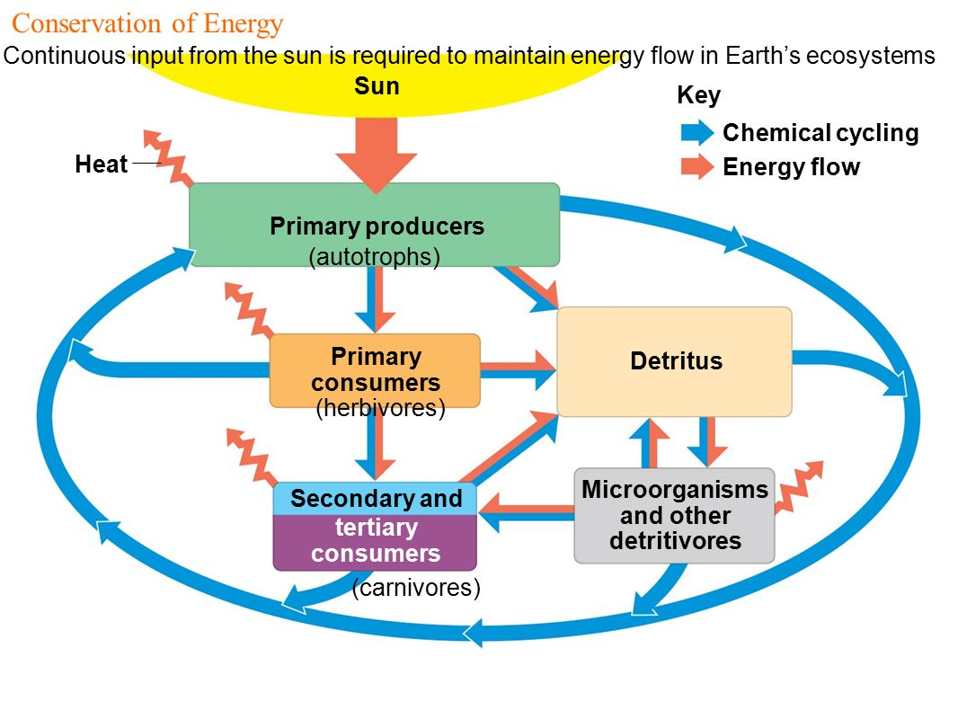
An overview of energy and nutrient dynamics in an ecosystem.

