Slide 1
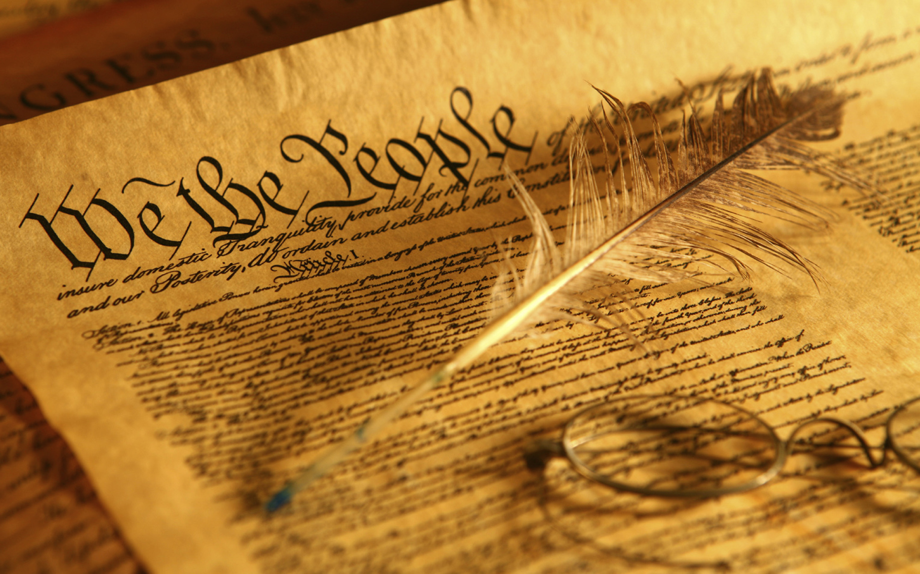
Amending The Constitution
We the People

Slide 2
Changing the Constitution
There were two paths of amending the Constitution:
The informal or “unwritten Constitution”
Based on tradition
The Presidential Cabinet-Established by tradition of Washington’s advisors
Judicial Review-Established by the Marbury vs. Madison (1803)
Congressional Committee System-Congress established this process to passing legislation
Political Parties-Arose from the ratification process of the Constitution (Federalist vs Anti-Federalist)
2 terms for presidents-Established by tradition of Washington serving only 2 terms. Formalized by the 22nd Amendment in response to FDR being elected to 4 terms
The formal method of passing an amendment
Done 27 times since 1788

Slide 3
CONSTITUTIONAL AMENDMENTS The Bill of Rights
Main purpose:
To address the concerns of the Anti-Federalists and protect people’s rights.
The Amendments:
1st | 1791 | Rights to Religion, Speech, Press, Assembly, Petition
2nd | 1791 | Right to Bear Arms
3rd | 1791 | Quartering of Soldiers
4th | 1791 | Search and Seizure
5th | 1791 | Grand Jury, Double Jeopardy, Self-Incrimination, Due Process
6th | 1791 | Rights of Accused in Criminal Prosecutions: Rights to Jury Trial, to Confront Opposing Witnesses and to Counsel
7th | 1791 | Jury Trial
8th | 1791 | Protections against Excessive Bail, Cruel and Unusual Punishment
9th | 1791 | Non-Enumerated (Listed) Rights are still Protected
10th | 1791 | Rights Reserved to States

Slide 4
CONSTITUTIONAL AMENDMENTS
The Amendments:
11th | 1795 | Suits Against a State
12th | 1804 | Election of President and Vice-President
13th | 1865 | Abolition of Slavery and Involuntary Servitude
14th | 1868 | Protects rights against state infringements, defines citizenship, prohibits states from interfering with privileges and immunities, requires due process and equal protection, punishes states for denying vote, and disqualifies Confederate officials and debts
15th | 1870 | Voting Rights for Former Slaves
16th | 1913 | Federal Income Tax
17th | 1913 | Popular Election of Senators
18th | 1919 | Prohibition of Manufacture and Sale of Alcohol
19th | 1920 | Women's Right to Vote
20th | 1933 | Commencement of Presidential Term and Succession
21st | 1933 | Repeal of 18th Amendment (Prohibition)
22nd | 1951 | Two-Term Limitation on President
23rd | 1961 | District of Columbia Residents Gain Presidential Vote
24th | 1964 | Abolition of Poll Tax Requirement in Federal Elections
25th | 1967 | Presidential Succession due to Vacancy, Disability and Inability
26th | 1971 | 18-year-olds Gain Right to Vote
27th | 1992 | Sets Procedure for Congressional Pay Raises

Slide 5
Ratification
Ratification of the Constitution took 2 ½ years to complete. States in order of ratification are:
1. Delaware (December 7, 1787) unanimous
2. Pennsylvania (December 12, 1787) 46 to 23
3. New Jersey (December 18, 1787) unanimous
4. Georgia (January 2, 1788) unanimous
5. Connecticut (January 9, 1788) 128-40
6. Massachusetts (February 6, 1788) 187-168
7. Maryland (April 24, 1788) 63-11
8. South Carolina (May 23, 1788) 149-73
9. New Hampshire (June 21, 1788) 57-47
10. Virginia (June 25, 1788) 89-79
11. New York (July 26, 1788) 30-27
12. North Carolina (November 21, 1789) 194-77
13. Rhode Island (May 29, 1790) 34-32

