Slide 1
Winter Holidays Around the World
A Webquest Exploration

Slide 2
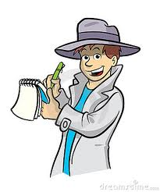
Instructions
Congratulations! You are now a journalist traveling the world to report on winter holidays celebrated around the world.
Your job is to gather basic information on several holidays then, pick one holiday and write a short news article about it. Your news article will need to provide basic information about the holiday, where it is celebrated, and how it is celebrated.

Slide 3
Instructions
Pick three of the six holidays found in the next slide
Click on the link to read about those holidays
Learn as much about those holidays as you can
Fill out the worksheet as you learn about the holidays

Slide 4
The Holidays
Pick THREE of these holidays to research. Click on the link to view that holidays information
Hogmonanay
Chahar Sanbeh Suri (Festival of Fire)
Kwanzaa
Christmas
Hannukah
Pancha Ganapati

Slide 5
Congratulations!
You have successfully explored 3 holidays!
Please follow the instructions on your worksheet to write an article focusing on ONE of these great holidays.
Please make your article fun and interesting to read while still providing your readers with accurate information.
Your article should be at least 500 words long but try to keep it under 1000.
You will turn in the article with your worksheet. MAKE SURE YOUR NAME IS ON BOTH!

